Slide 1
mental health AND gender disparity in occupations
Sara Boubekri
Medical Student
Dr Tomas Paus’ Lab
CHU Sainte-Justine University of Montreal

Slide 2
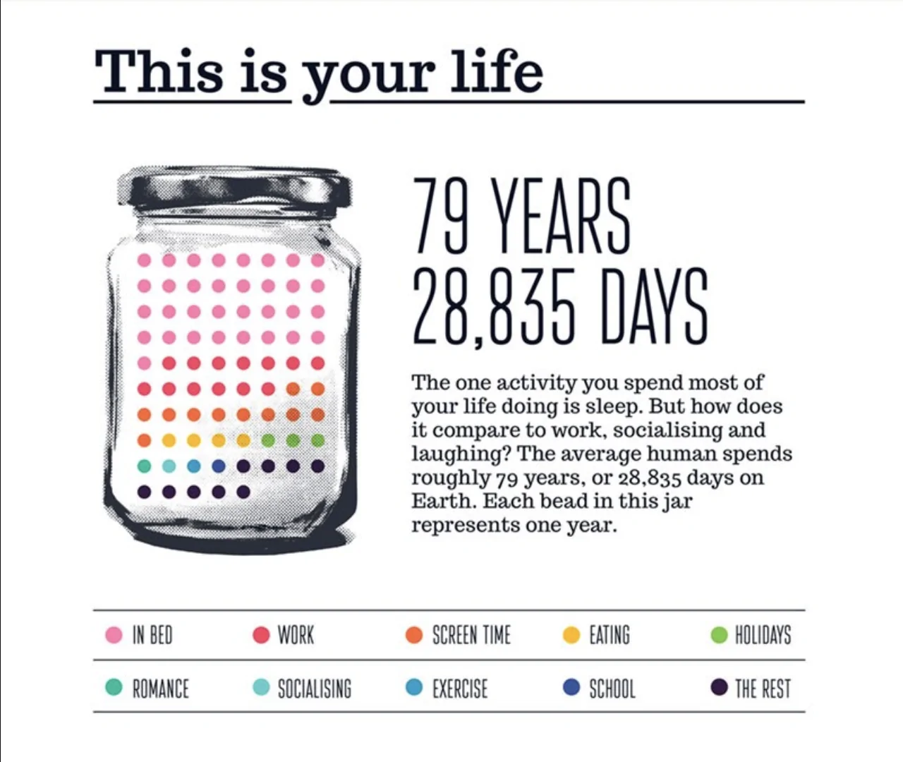
Imagine that your life could be put in a jar…
Reference: https://www.dreams.co.uk/sleep-matters-club/your-life-in-numbers-infographic
Notes:
A first question that is legitimate to ask is, why focusing on gender disparity at work. Well. Imagine that your life could be put in a jar. This survey lead in the UK intended to quantify the time one spends on daily activity such as resting, working, or eating on one’s lifetime. Each colored bead represent one year, and there is 79 colored beads in the jar, which is the life expectancy in the UK.

Slide 3
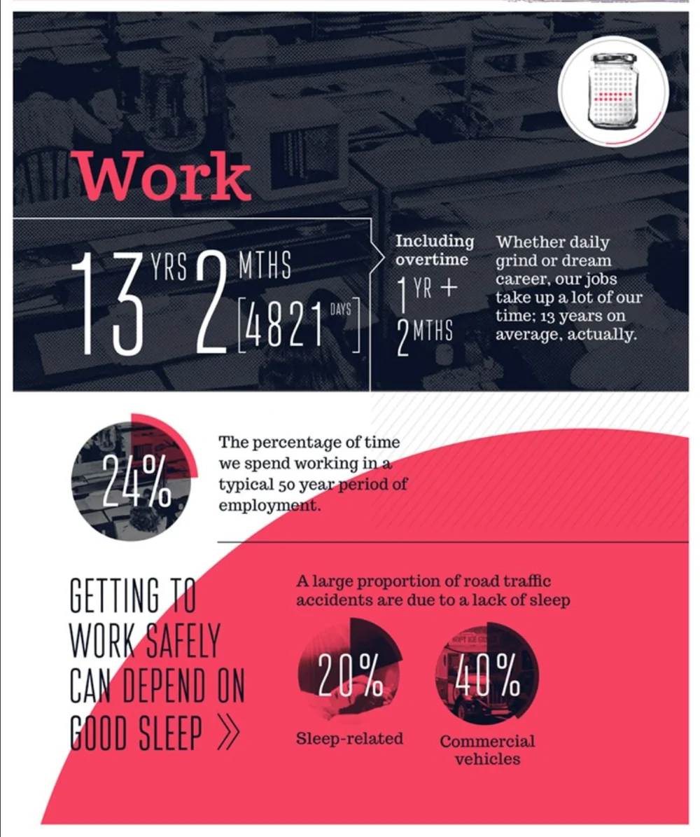
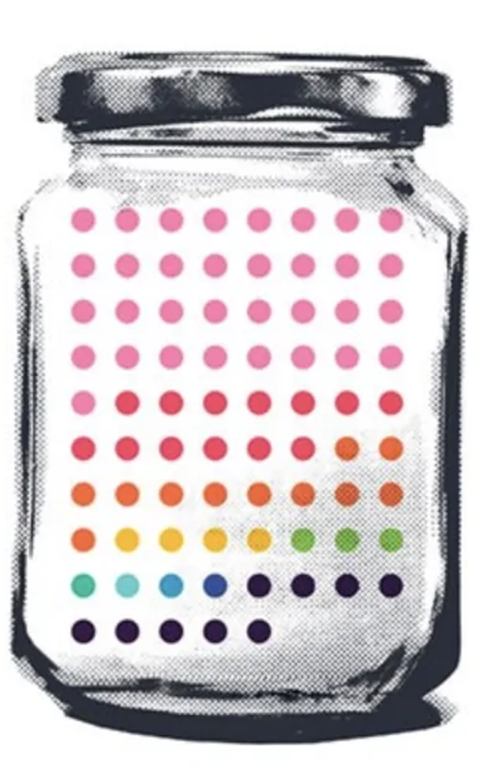
Reference: https://www.dreams.co.uk/sleep-matters-club/your-life-in-numbers-infographic
Notes:
In this jar, there would be 13 red beads, representing 13 full years of your life that you spend work. In other words, one spends almost a fourth of one’s waking hours at one’s workplace., which is a colossal amount of time.
Thus, it is likely that any occurrences within the professional sphere impact one's personal well-being.

Slide 4
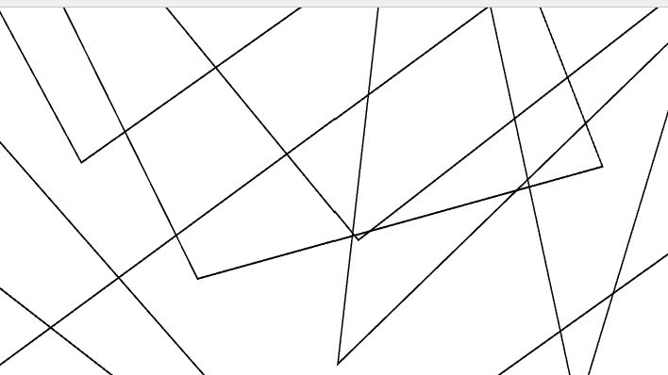
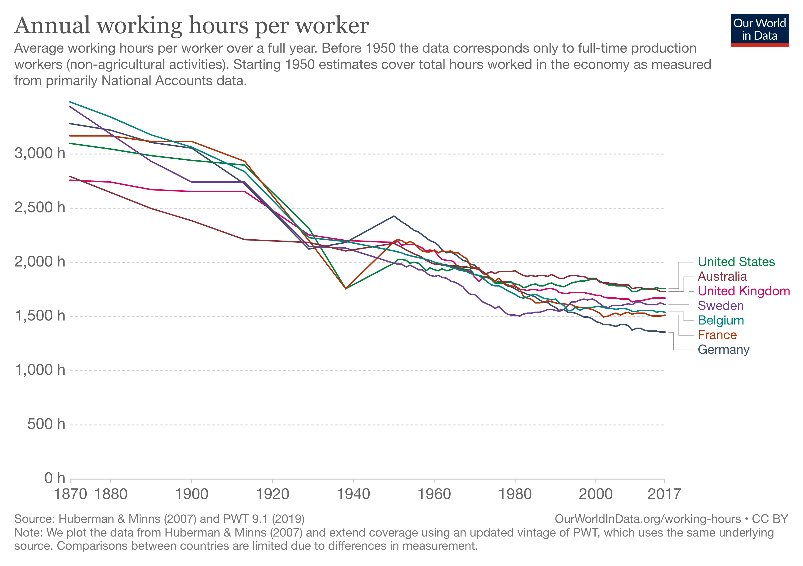
Reference: https://ourworldindata.org/grapher/annual-working-hours-per-worker?time=earliest..latest
Notes:
Now, our research being a longitudinal study through time, I wanted to include this graph based on the Total Economy Database: From 1870 to 2017, the average worker in the Western world goes from working 3000 hours by year to around 1500 hours. In a bit less than 150 years, we see the annual working hours per worker deceasing by almost 50%. Now, does it mean that we give less importance now to work than ever before? No, it simply means that our relation to work has drastically change. In the last century, what took so long to the workers was the repetitive, mechanical, draining tasks they were doing. With all the tools and techniques that have been developed since now, we can allow ourselves to put much more of our humanity into our work. Work now has many more functions to us than only being able to buy bread, like it was 100 years ago. It has much more meaning to us and therefore we expect that whatever happens in the workplace will impact one’s well-being.

Slide 5
OUR HYPOTHESIS
MORE GENDER DISPARITY IN THE WORKPLACE
Poorer mental health
Notes:
That is indeed our hypothesis. We expect that more gender disparity in the workplace will lead to poorer mental health in the population.

Slide 6

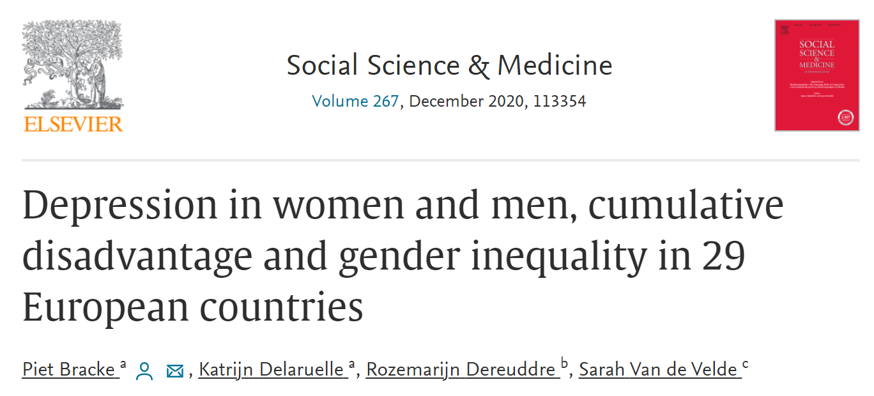
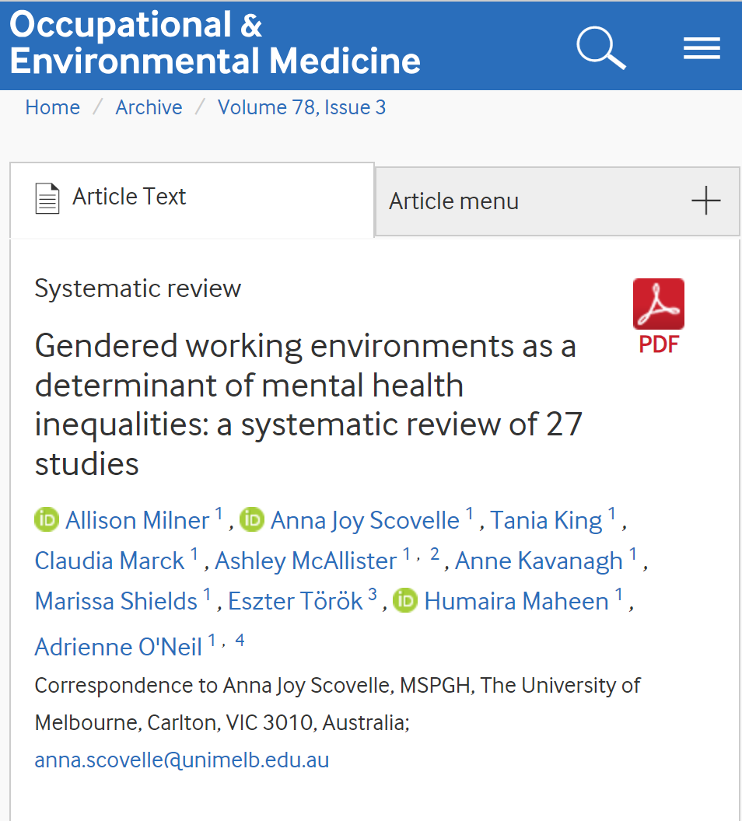
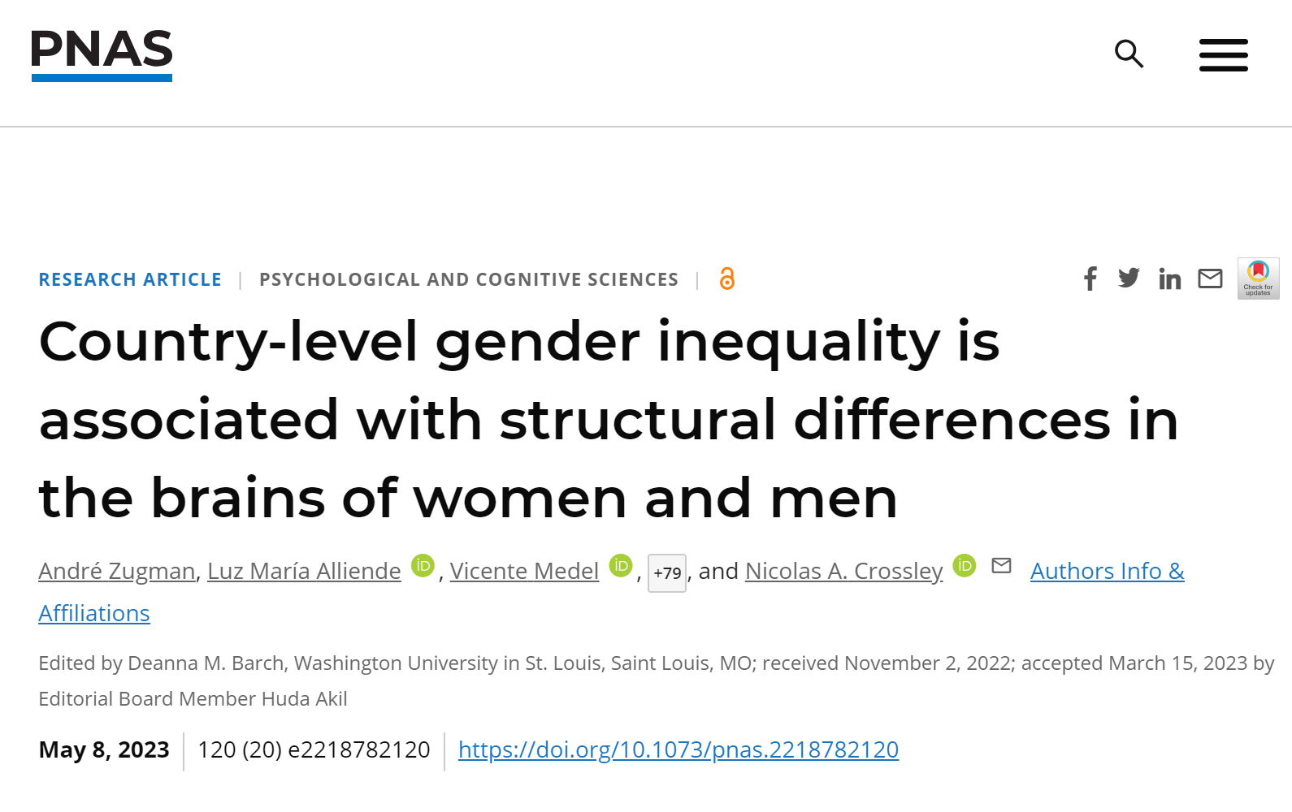
Notes:
We are not the only ones studying this subject. People are interested in finding associations between gender inequity and mental health and they do it in different manner.
Study 1
In this first study published in Social Science and Medicine, gender inequality has been studied in the context of the European Social Survey. The main finding was that in countries with greater gender equality, the prevalence of depression was not only lower, but also more similar between the two sexes.
Study 2
In this second study published in the PNAS, brain imaging was used in association with the Gender Inequality Index of the United Nations to study brain changes that could be related to country-level gender inequality. The results shows that women present thinner cortices – especially in the limbic regions – compared to men only in gender-unequal countries.
Study 3
Finally, in this meta-study published in the BMJ journal, specific exposures of gendered working environment were examined. Interesting findings include that women’s mental health was more likely to be affected by long working hours than men’s, while precarious employment was more likely to be negatively associated with men’s mental health.

Slide 7

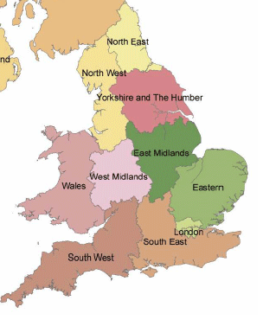
Research Question
Notes:
All good, people are interested in what we are researching. Now, how do we go about studying a possible relationship between mental health and gender disparity.
Well, thanks to another project in the lab, we have access to the mental health data of the UK BioBank, which is a huge with gathering of health information from half a million UK participants.
For the gender disparity part, we therefore decided to choose England and Wales as the area studied.

Slide 8
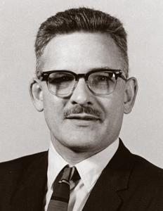
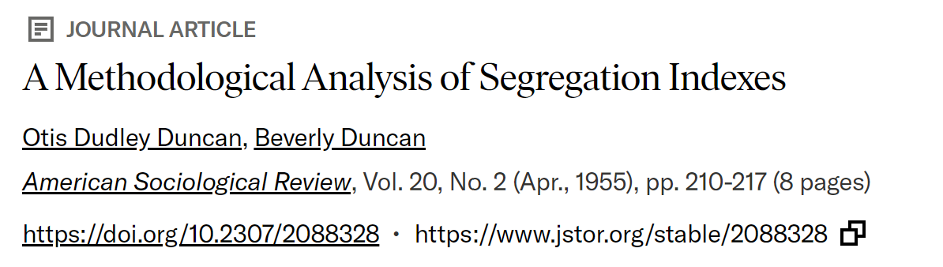
the Duncan index of Segregation
Source: https://www.jstor.org/stable/2088328
Notes:
Now, to evaluate gender disparity in occupation, we used the Duncan Index of segregation. This measure of segregation was first used by the economist Otis Duncan and his wife in a study on gender segregation in the workplace, presicely.

Slide 9
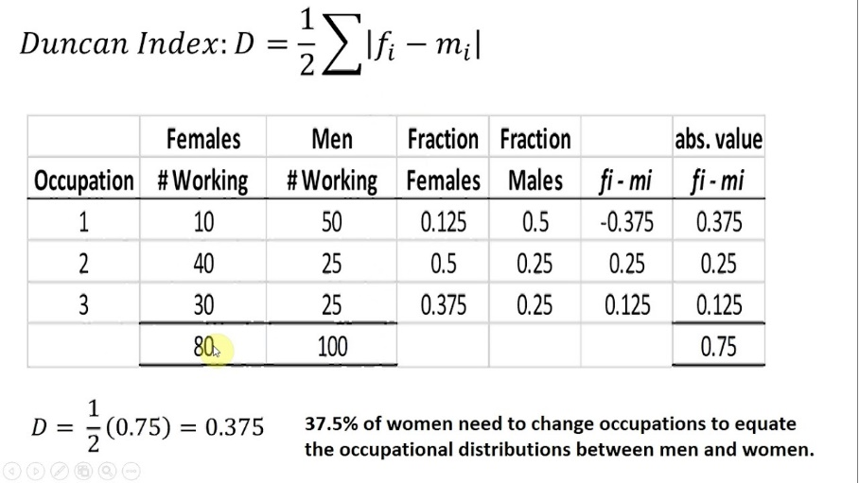
Males
80
For equitable gender distribution in occupations
37.5% of female workers need to change occupation
Reference: https://www.youtube.com/watch?v=mg3amI0Z8D8
Notes:
This formula gives nice and easy to interpret results. Let me guide you through it.

Slide 10

n = 84,136,315
10 regions
North East
North West
Yorkshire and the Humber
East Midlands
West Midlands
East
London
South East
South West
Wales
6 Census
1971
1981
1991
2001
2011
2021
Reference: https://www.researchgate.net/figure/Map-of-Government-Office-Regions-GORs_fig1_4843923
Notes:
To sum up, we have 10 regions, 6 census from different decades, and over 84 millions of data. We are all set on the space-time level.

Slide 11

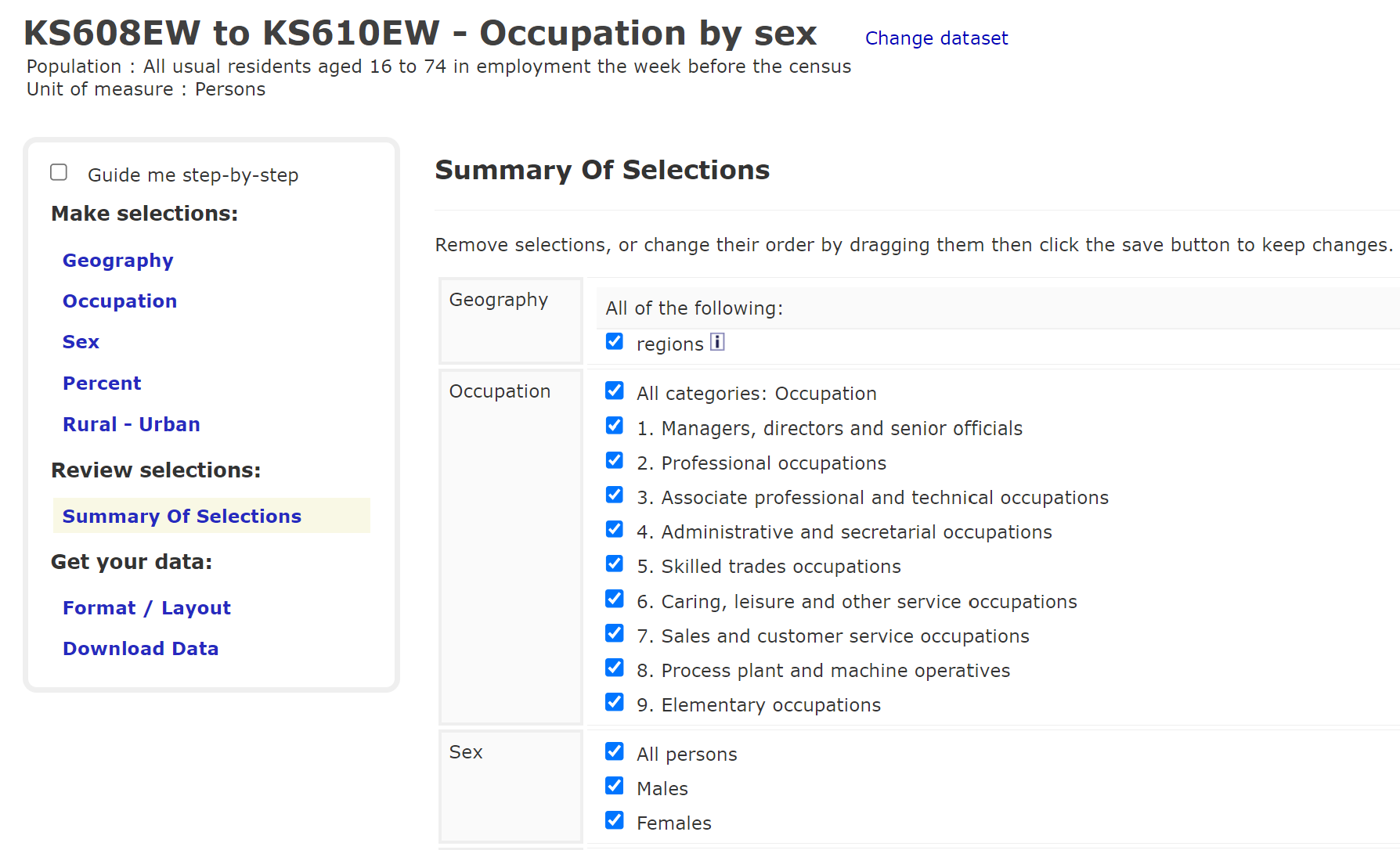
What is the Duncan index?
USE IN PREVIOUS RESEARCH
xxxxxxxx
EXAMPLE
xxxxxxxxx
INTERPRETATION OF THE RESULTS
xxxxxxxxxx
Reference: https://www.nomisweb.co.uk/query/construct/summary.asp?menuopt=200&subcomp=
Notes:
There is, what is called the SOC or the Standard Occupational Classification, which is a standard way to classify the occupations across census. To collect the data, the public website of the UK Office for National Statistics was used.

Slide 12
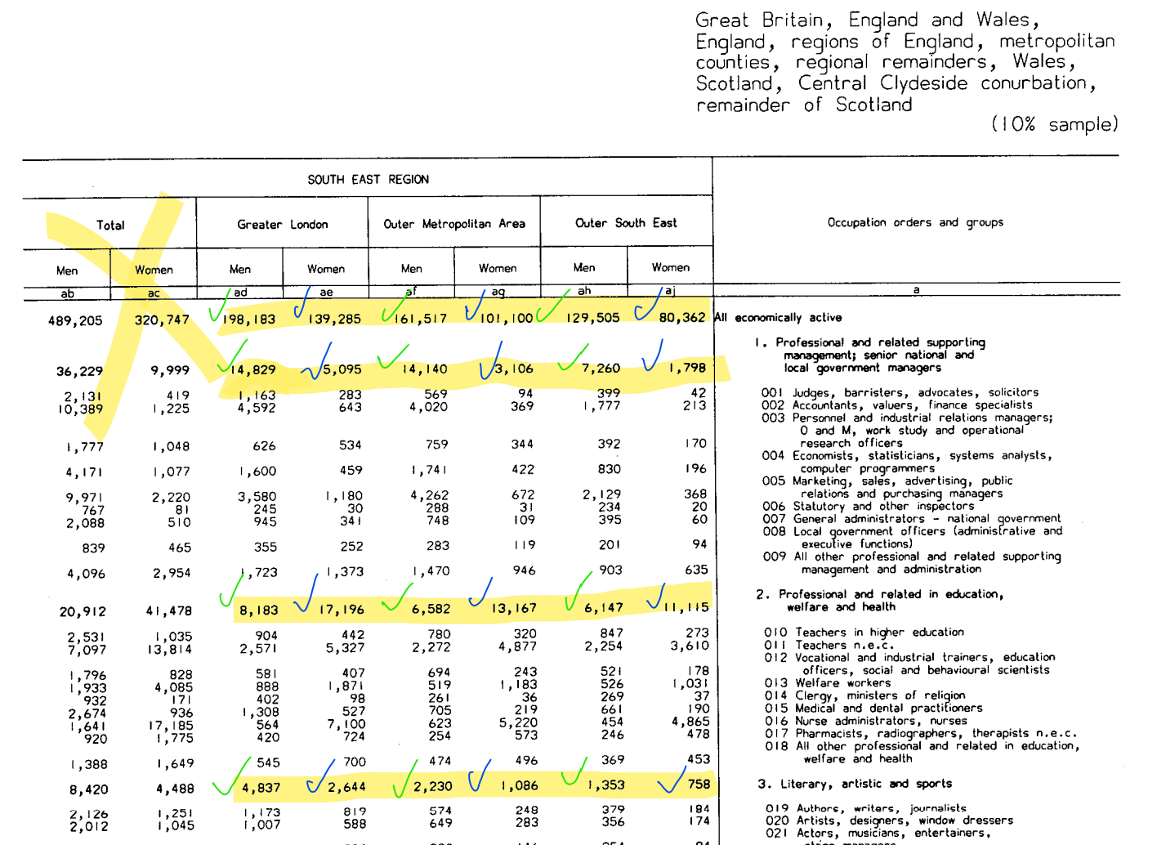
Census 1981 – Occupation by sex
USE IN PREVIOUS RESEARCH
xxxxxxxx
EXAMPLE
xxxxxxxxx
INTERPRETATION OF THE RESULTS
Reference: https://www.nomisweb.co.uk/query/construct/summary.asp?menuopt=200&subcomp=
Notes:
However, this occupational classification was not used prior 1981. As you can see, these scans were forwarded to us by Sue, an employee from the office of National Statistics that greatly helped us in the data collecting phase.

Slide 13
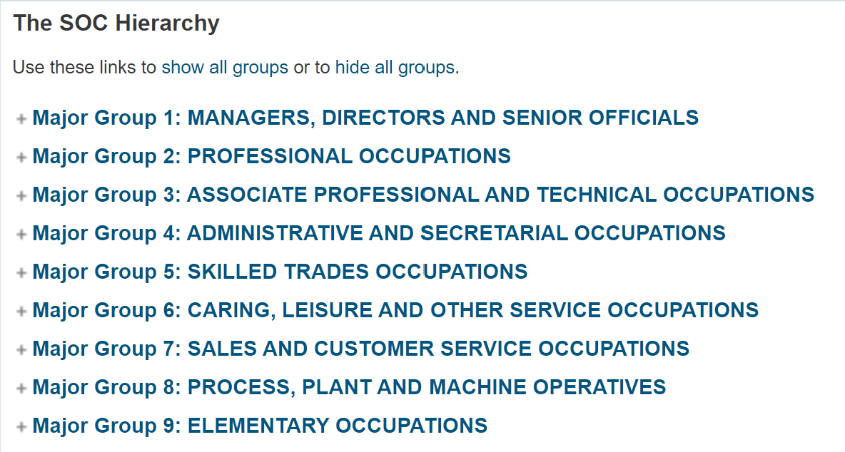
Standard occupational classification
Reference: https://onsdigital.github.io/dp-classification-tools/standard-occupational-classification/ONS_SOC_hierarchy_view.html
Notes:
We harmonized to occupational classification across all census however since the SOC was built in order to account for these differences.
Those are the 9 major groups that you can see her.
Each specific occupation has a 4-digit code that gives information about its grouping.

Slide 14
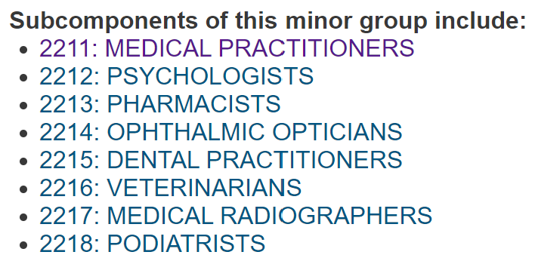
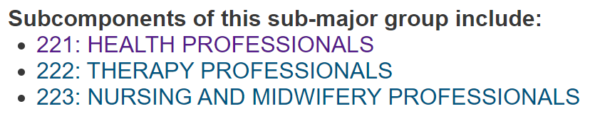

Reference: https://onsdigital.github.io/dp-classification-tools/standard-occupational-classification/ONS_SOC_hierarchy_view.html
Notes:
Let’s take medical practitioners for example.

Slide 15
rESULTS
Notes:
Now let’s go to the fun part. The results.

Slide 16

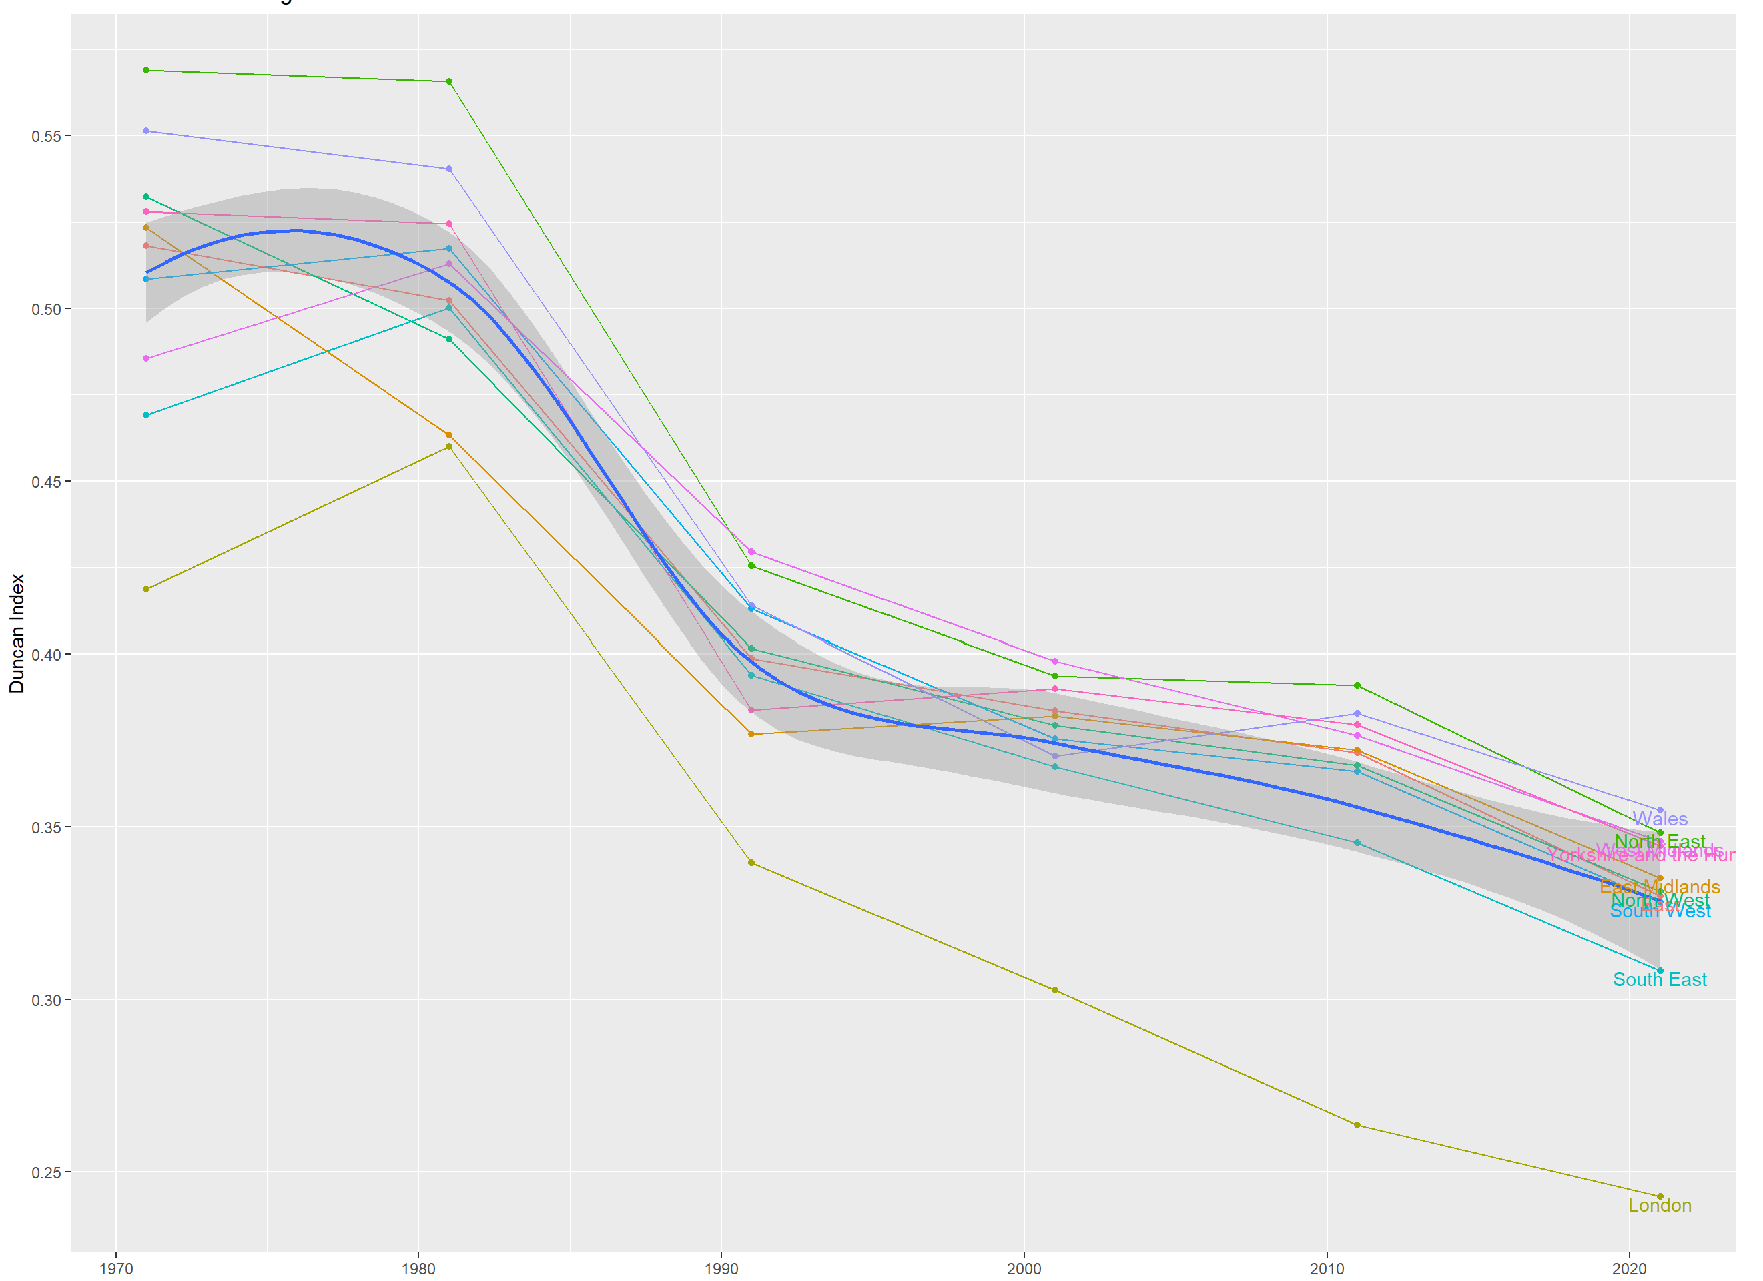
results
EVOLUTION OF THE SEGREGATION INDEX OF SPECIFIED ENGLAND AND WALES REGIONS FROM 1971 TO 2021
0.55
0.50
0.45
Duncan Index Value
0.40
XXXXXXXXX
0.35
0.30
0.25
1970
1980
1990
2000
2010
2020
Census Year
Notes:
Explain the graph. Point out London DI evolution

Slide 17
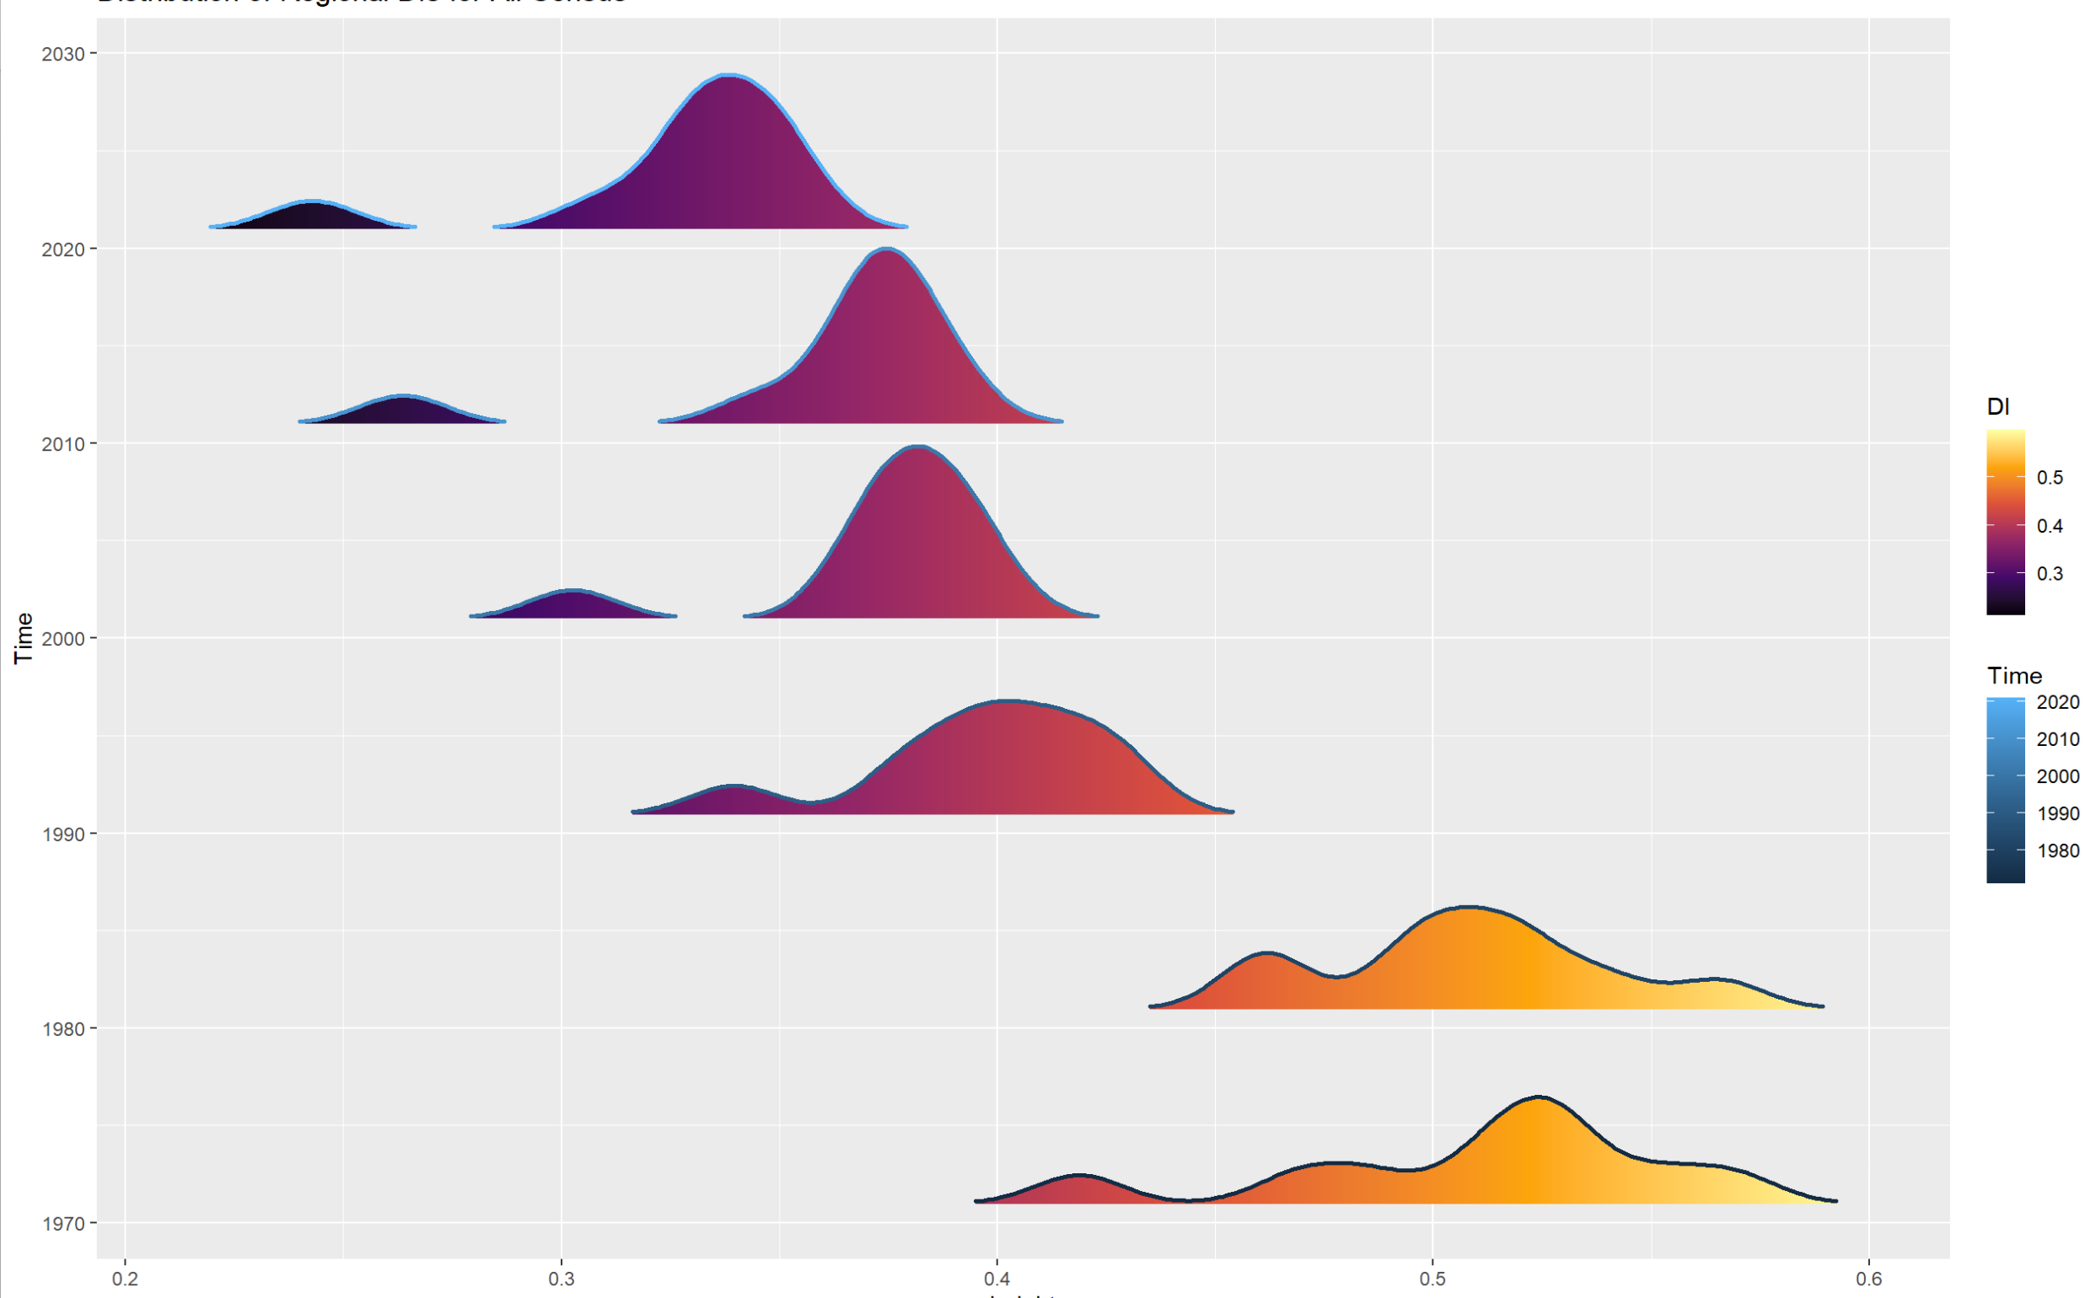
results
PREVALENCE OF SPECIFIED DUCAN INDEX OF SEGREGATION BETWEEN 1971 TO 2021 ACROSS ENGLAND AND WALES REGIONS
2020
2010
Census Year
2000
XXXXXXXXX
1990
1980
1970
0.2
0.3
0.4
0.5
0.6
Duncan Index Value
Notes:
Explain the graph.
Point out that there is a significant decrease of DI in each census.

Slide 18
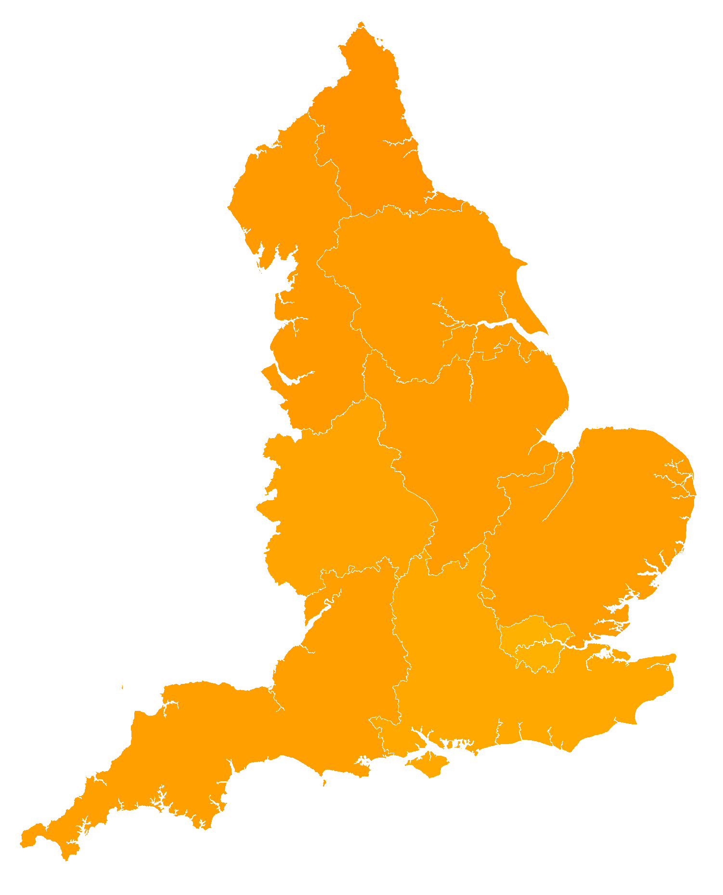

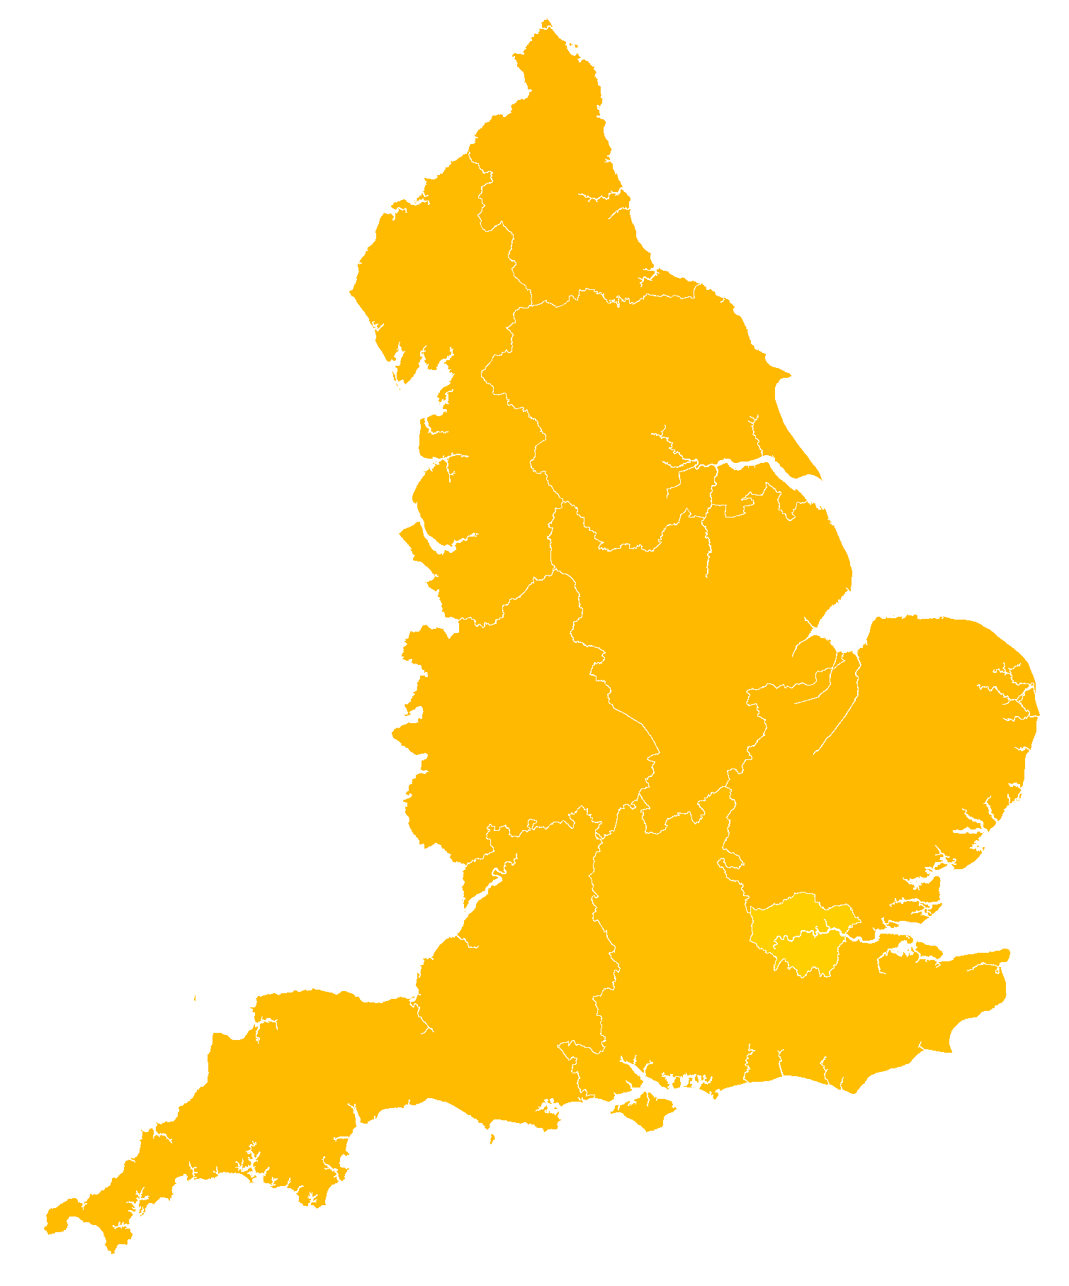
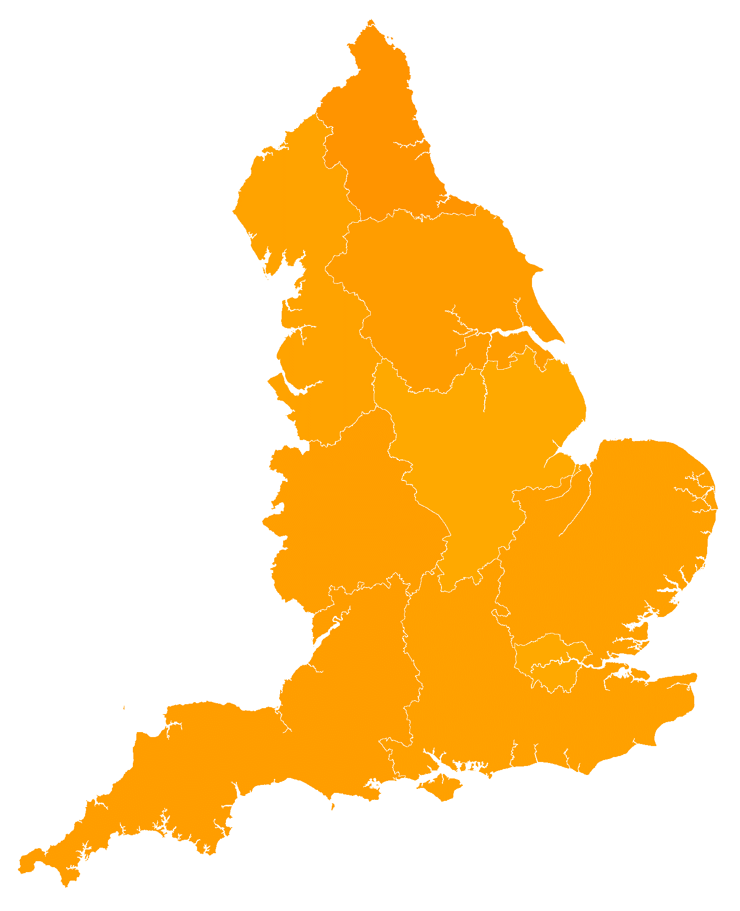

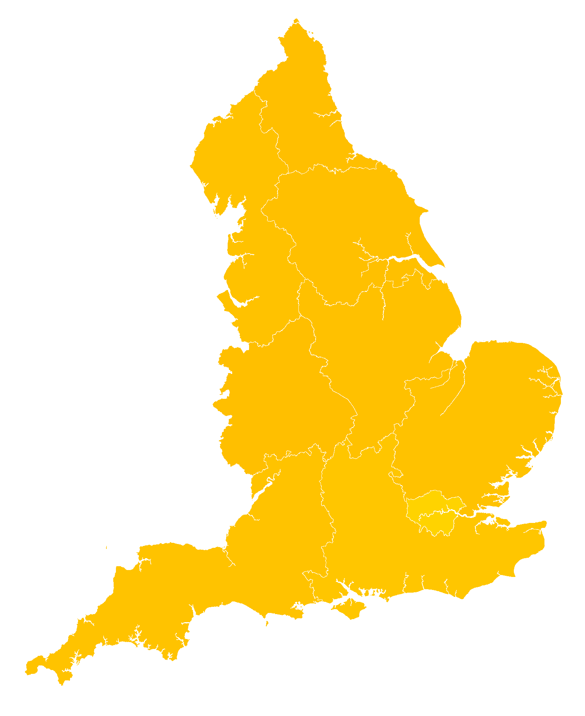
1971
1991
2011
1981
2001
2021

Slide 19
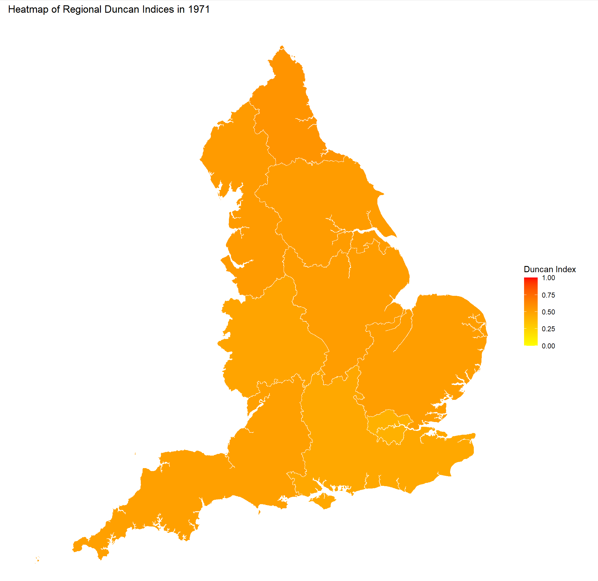
Heatmap of Regional Duncan Indices in 1971

Slide 20
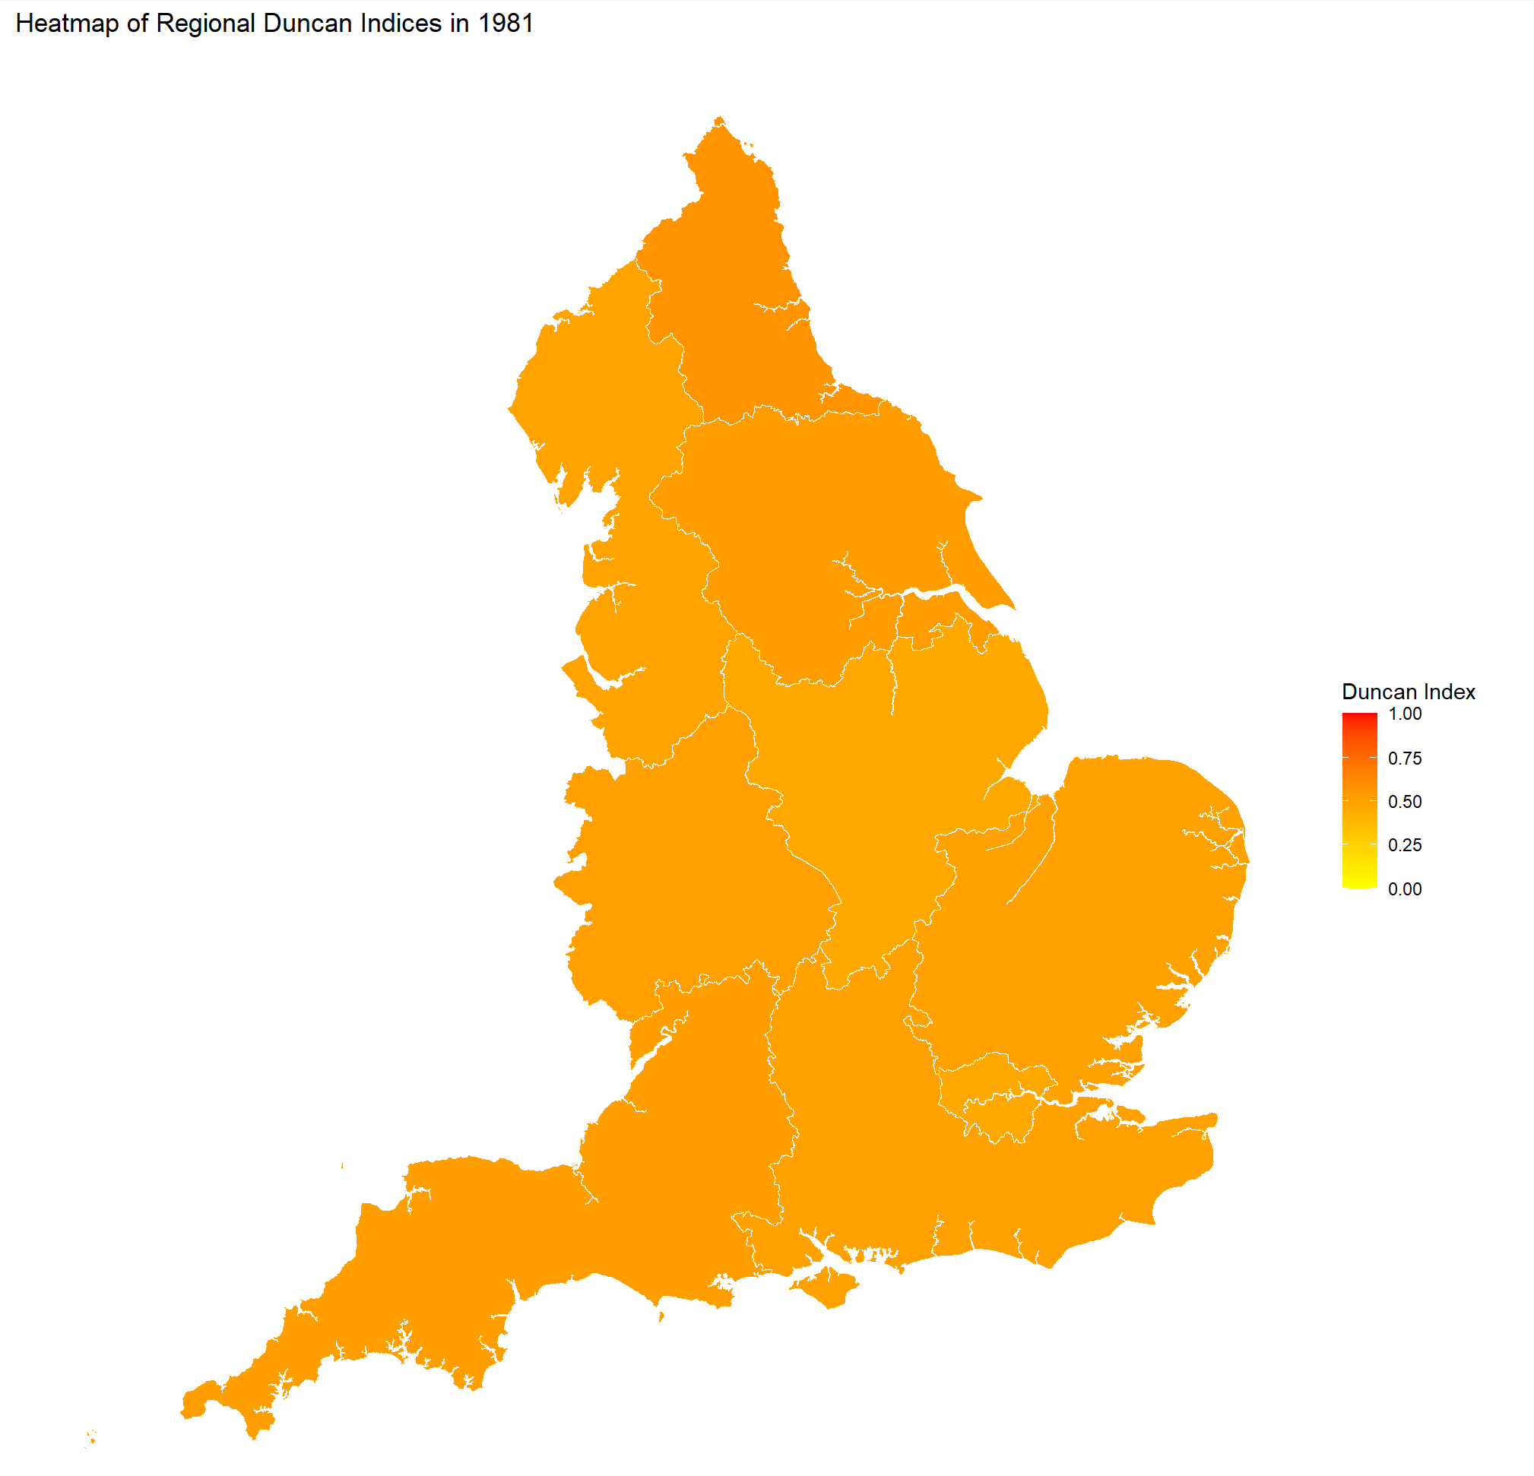
Heatmap of Regional Duncan Indices in 1981

Slide 21
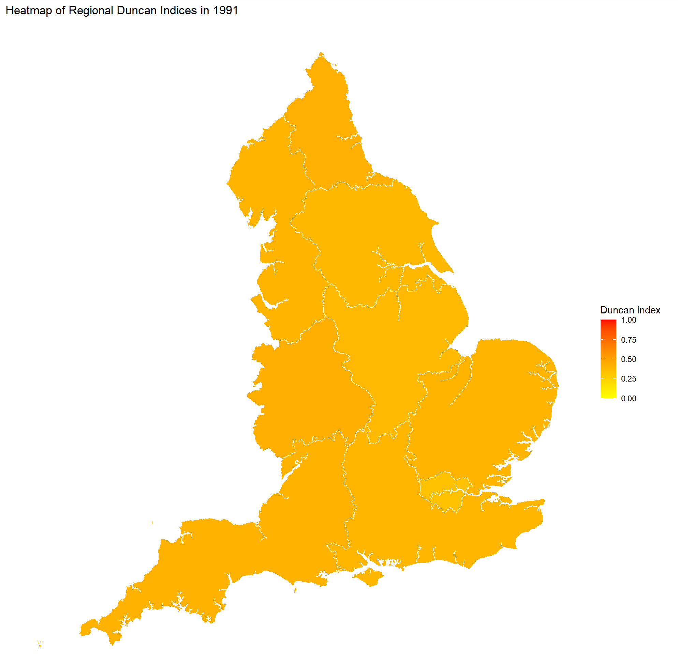
Heatmap of Regional Duncan Indices in 1991

Slide 22
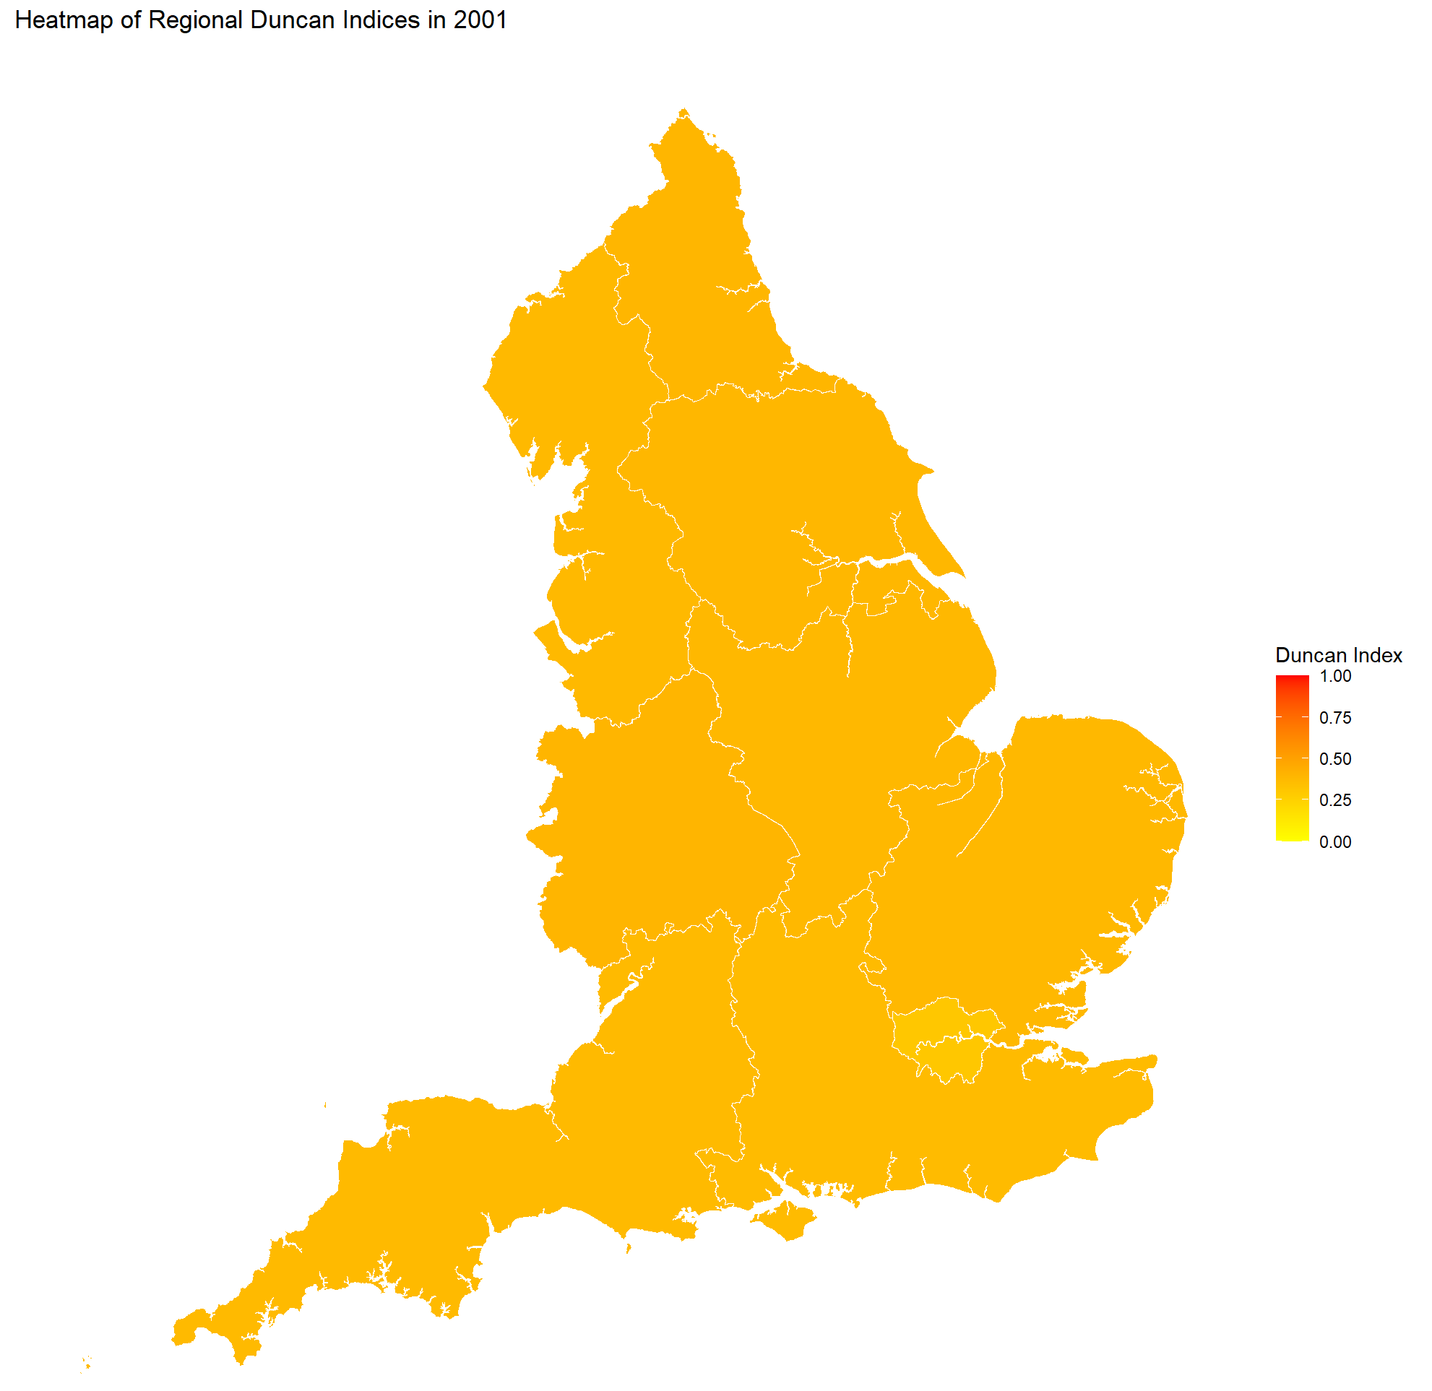
Heatmap of Regional Duncan Indices in 2001

Slide 23
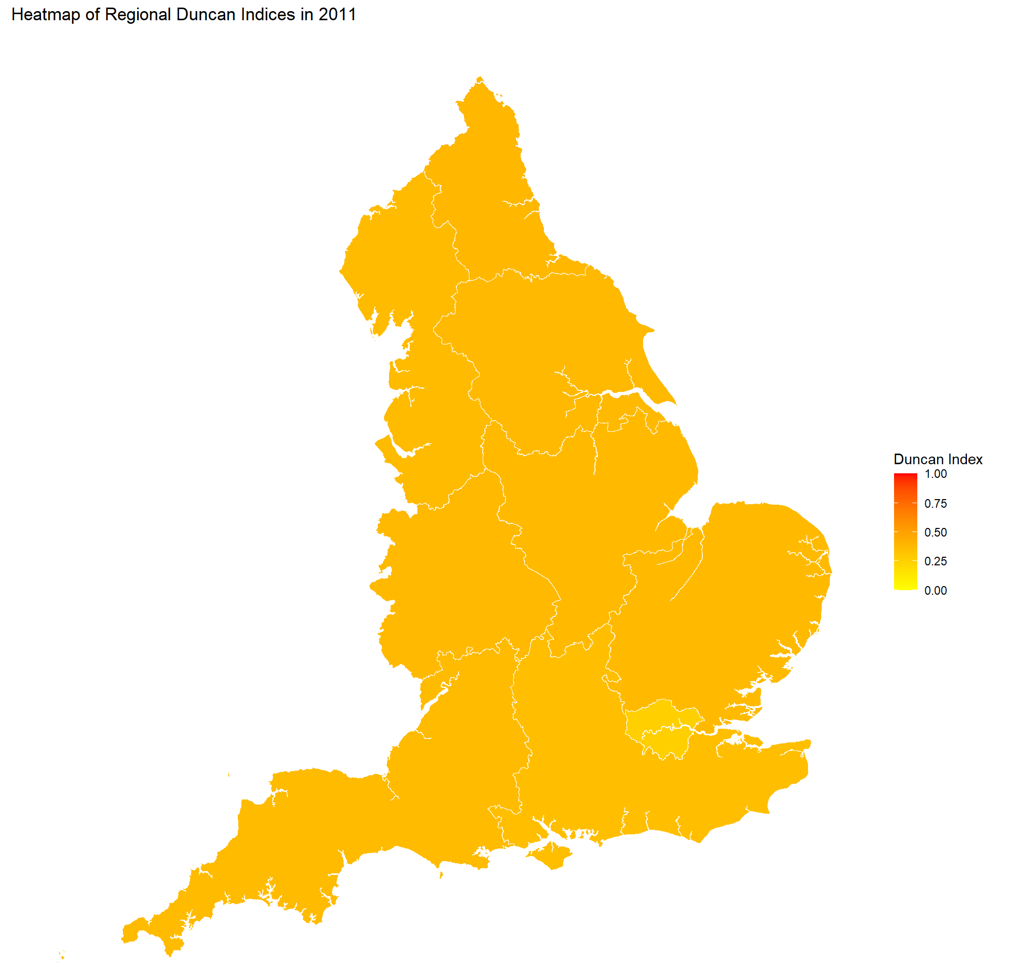
Heatmap of Regional Duncan Indices in 2011

Slide 24
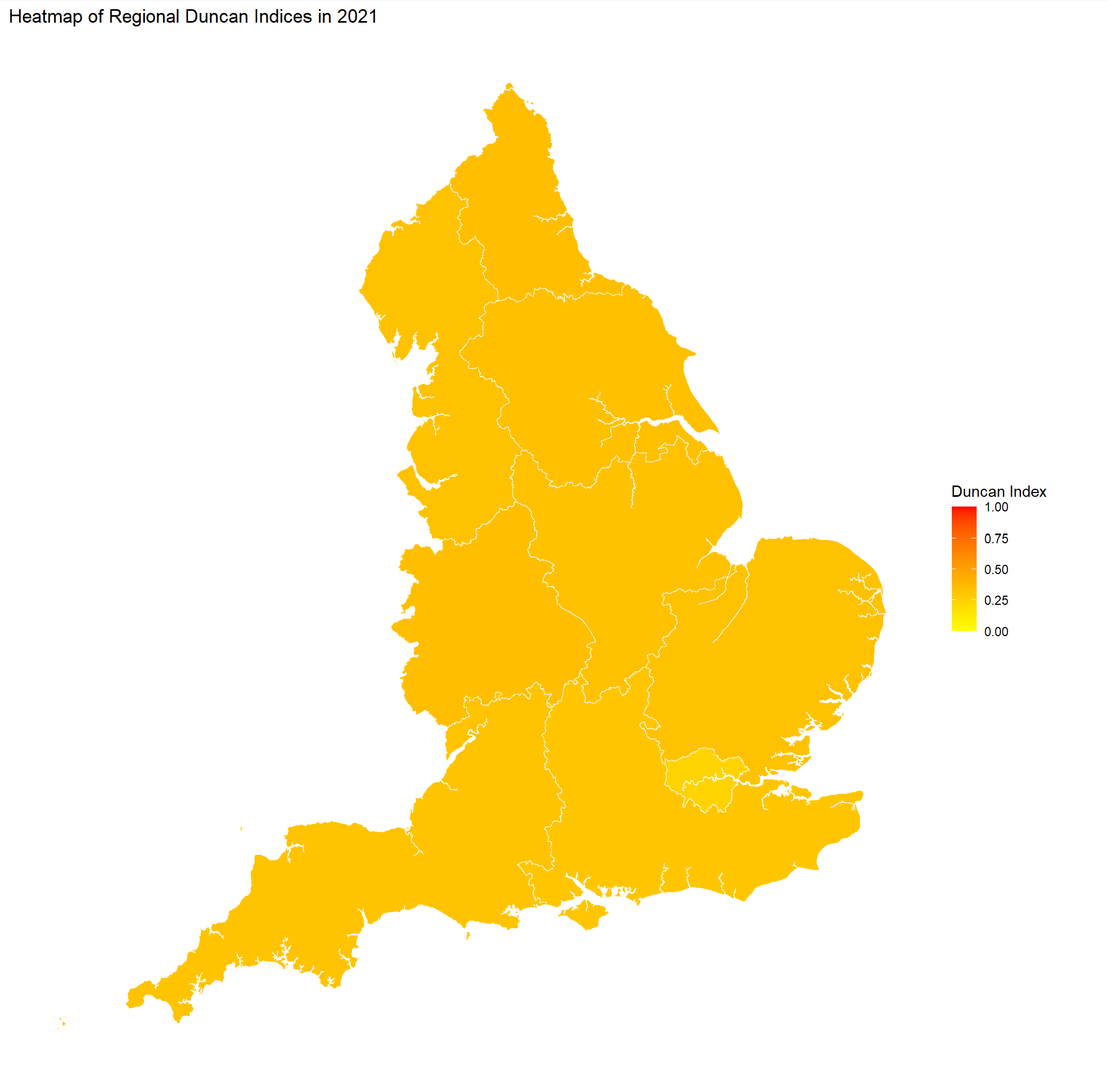
Heatmap of Regional Duncan Indices in 2021

Slide 25
Degree of Significance of the Observed Difference in Duncan Index Mean through Time
p-values | Census 1971 | Census 1981 | Census 1991 | Census 2001 | Census 2011 | Census 2021
Census 1971 | NA | 0.1977 | 2.04e-06 | 1.555e-07 | 2.203e-09 | 6.251e-10
Census 1981 |  | NA | 4.732e-06 | 3.193e-06 | 6.06e-07 | 1.376e-07
Census 1991 |  |  | NA | 9.993e-06 | 9.262e-06 | 1.376e-07
Census 2001 |  |  |  | NA | 0.01518 | 6.692e-07
Census 2011 |  |  |  |  | NA | 4.452e-08
Census 2021 |  |  |  |  |  | NA
……..Green: p-value < 0.05……………………………Grey: p-value > 0.05………
Notes:
A t-test, paired by region, was performed across each Census.
Pretty much significant within 95% confidence interval, with one exception

Slide 26
What’s NExT?

Slide 27
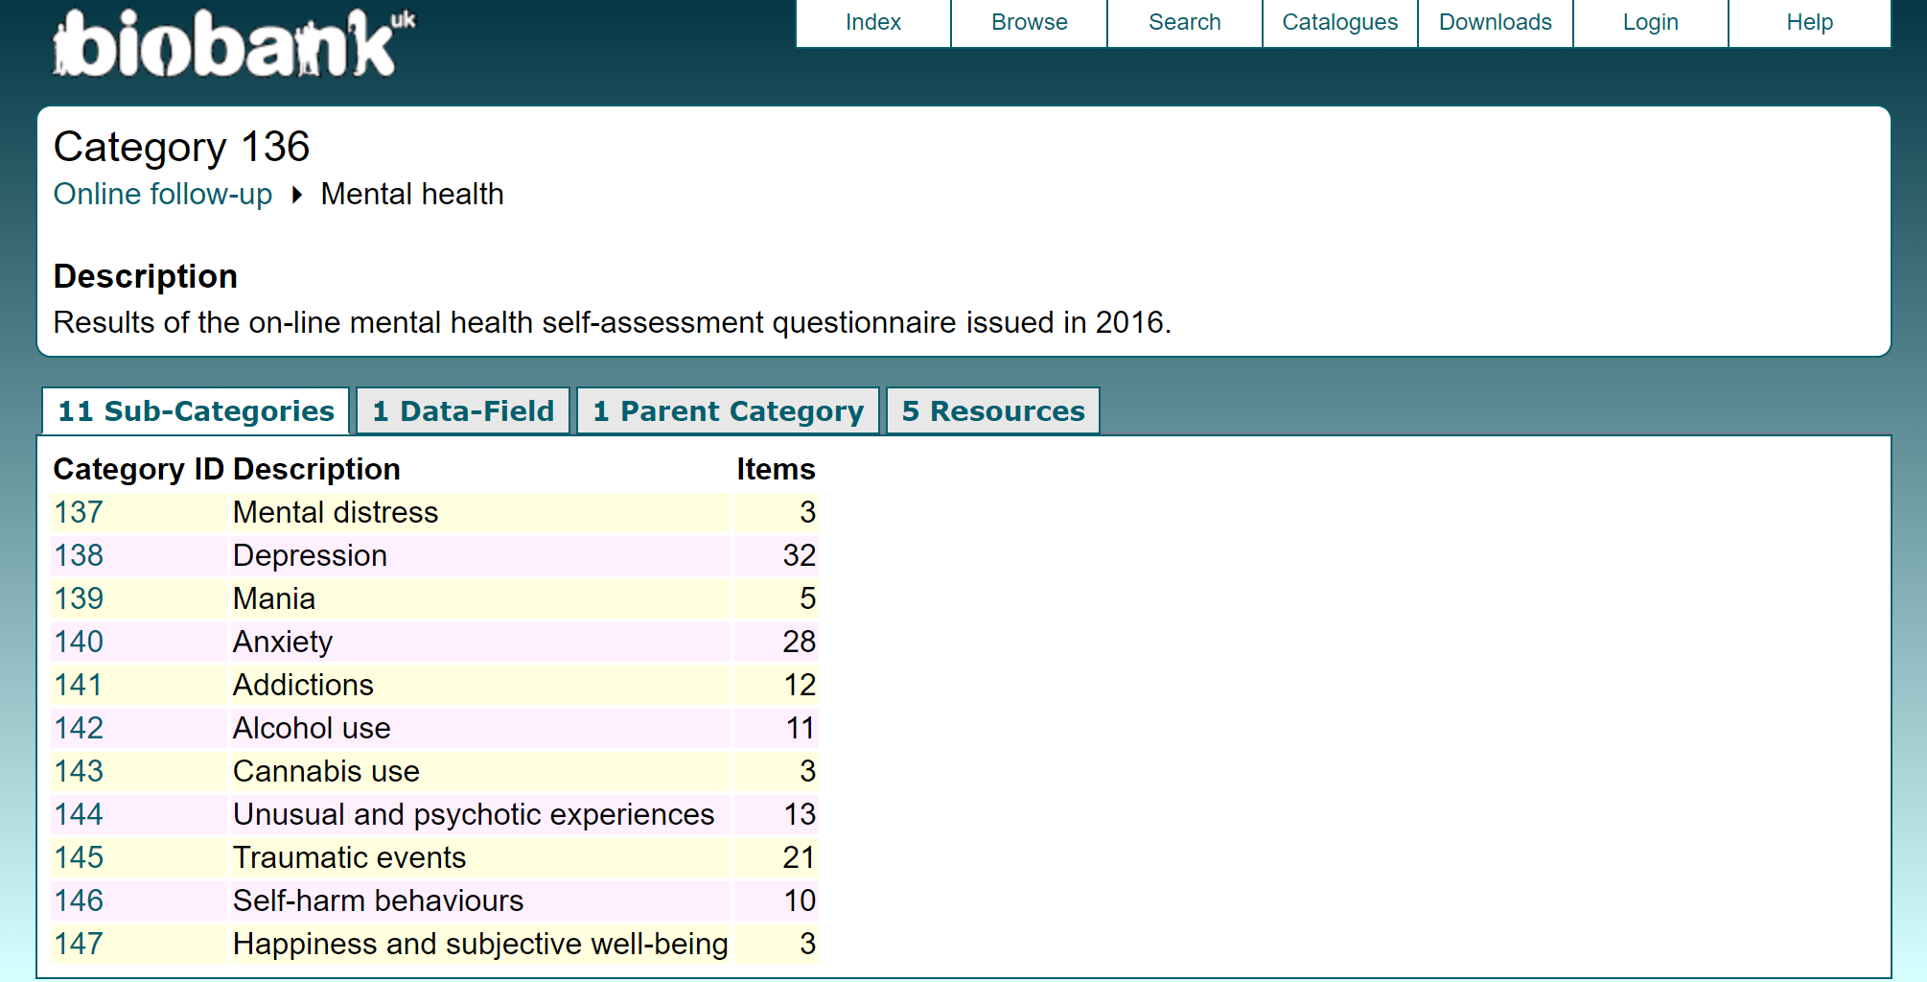
N =157,298
Notes:
Self assessment of
One of the distinctive of the project is that it is not only depression
We will start with self-assessed → n

Slide 28
BIBLIOGRAPHY
PWT 9.1 (Ed.). (2019). Annual working hours per worker. In The World in Data. https://ourworldindata.org/grapher/annual-working-hours-per-worker?time=earliest..latest
Duncan, O. D., & Duncan, B. (1955). A Methodological Analysis of Segregation Indexes. American Sociological Review, 20(2), 210–217. https://doi.org/10.2307/2088328
Margaret A. Sheridan, Measuring the impact of structural inequality on the structure of the brain, Proceedings of the National Academy of Sciences, 120, 25, (2023).
Chen, Y. Y., Subramanian, S. V., Acevedo-Garcia, D. & Kawachi, I. Women’s status and depressive symptoms: A multilevel analysis. Soc. Sci. Med. 60, 49–60 (2005).
McLaughlin, K. A., Xuan, Z., Subramanian, S. V. & Koenen, K. C. State-level women’s status and psychiatric disorders among US women. Soc. Psychiatry Psychiatr. Epidemiol. 46, 1161–1171 (2011).
Van de Velde, S., Huijts, T., Bracke, P. & Bambra, C. Macro-level gender equality and depression in men and women in Europe. Sociol. Heal. Illn. 35, 682–698 (2013).
Bracke, P., Delaruelle, K., Dereuddre, R. & Van de Velde, S. Depression in women and men, cumulative disadvantage and gender inequality in 29 European countries. Soc. Sci. Med. 267, 113354 (2020).
ACKNOWLEDGEMENTS
UK OFFICE FOR NATIONAL STATISTICS Sue Phillips
DR TOMAS PAUS’ LAB
Tomas Paus Daniel Vosberg
Xavier Navarri Amine Boumesmar
Zhijie Liao James Hengenius
MCGILL UNIVERSITY
Yanis Bencheikh

Slide 29
THANK YOU
Questions?
Sara Boubekri
Medical Student
Dr Tomas Paus’ Lab at CHU Sainte-Justine University of Montreal
sara.boubekri@umontreal.ca

Slide 30
complementary slides

Slide 31
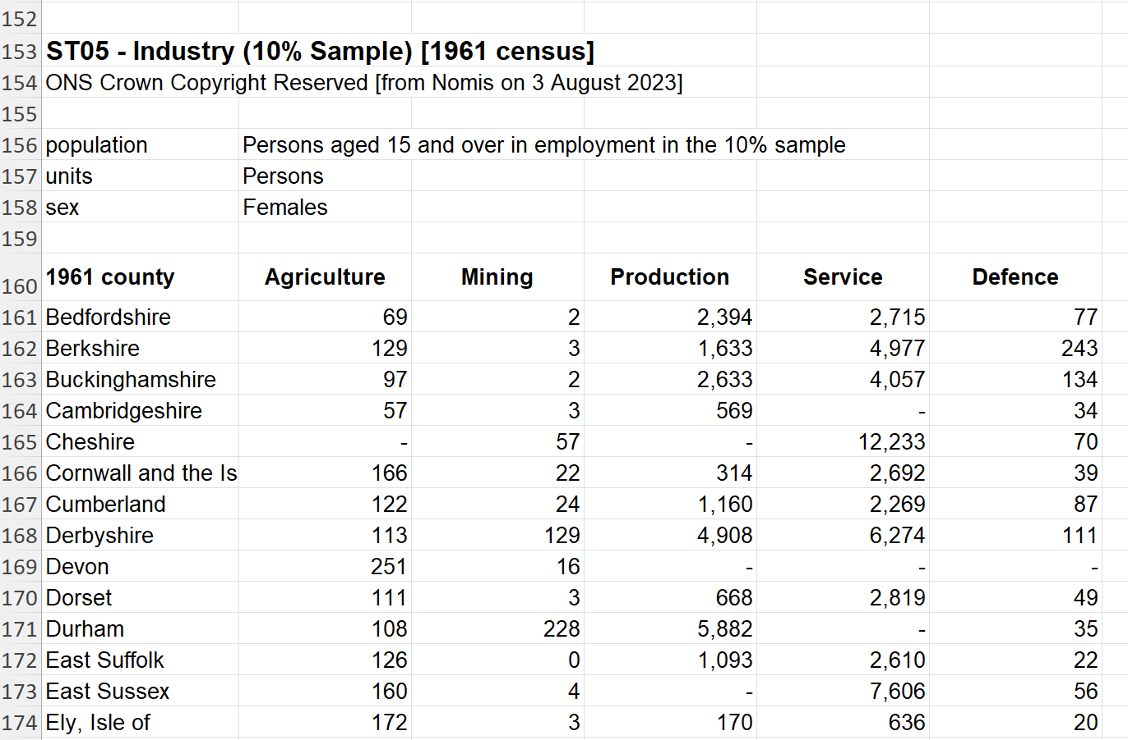
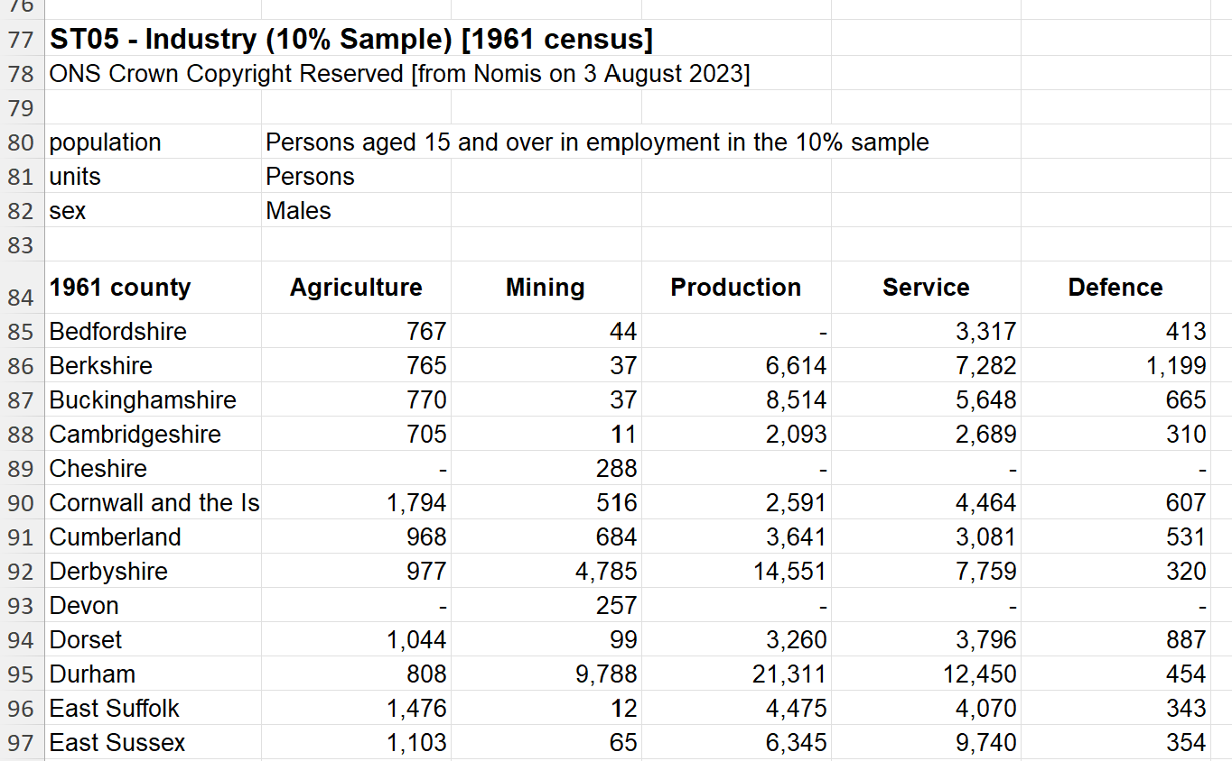
Why the cut oFf is 1971?
MISSING DATA
DIFFERENT GEOGRAPHY
DIFFERENT OCCUPATIONAL CLASSIFICATION
SMALL NUMBER OF PARTICIPANTS

Slide 32
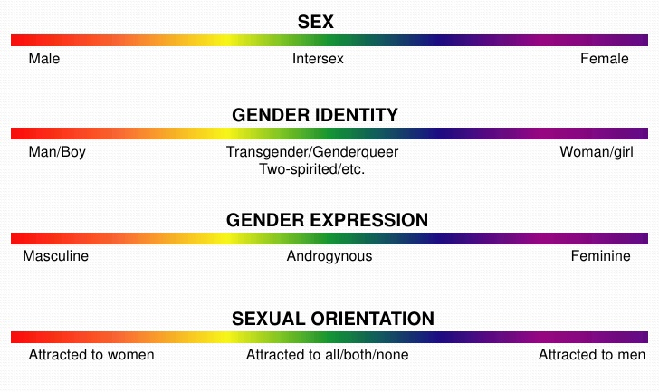
Continuum of Sex, Gender Identity, Gender Expression and Sexual Orientation
USE IN PREVIOUS RESEARCH
Reference: https://scalar.usc.edu/works/index-2/media/the-gender-spectrum

Slide 33
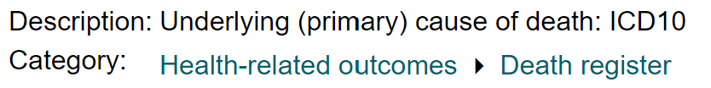
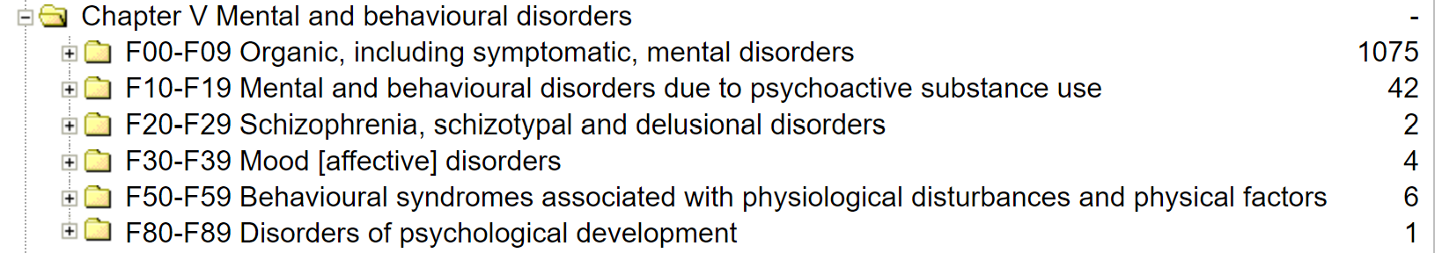
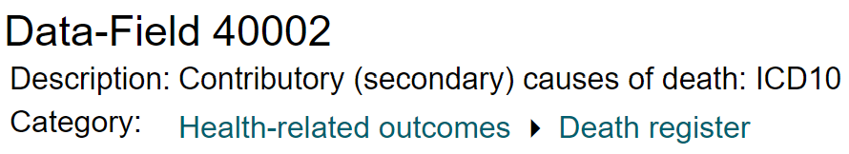
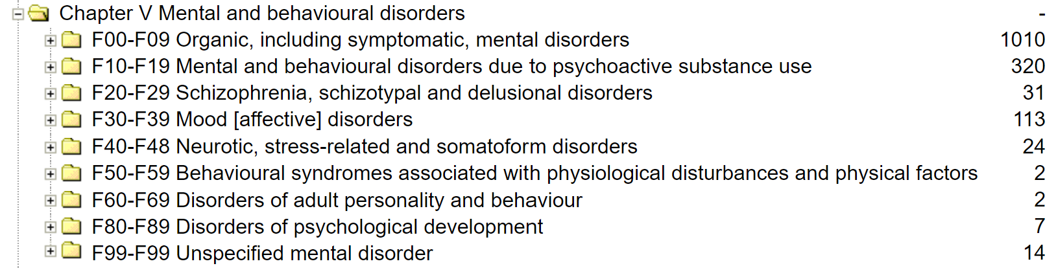

Slide 34
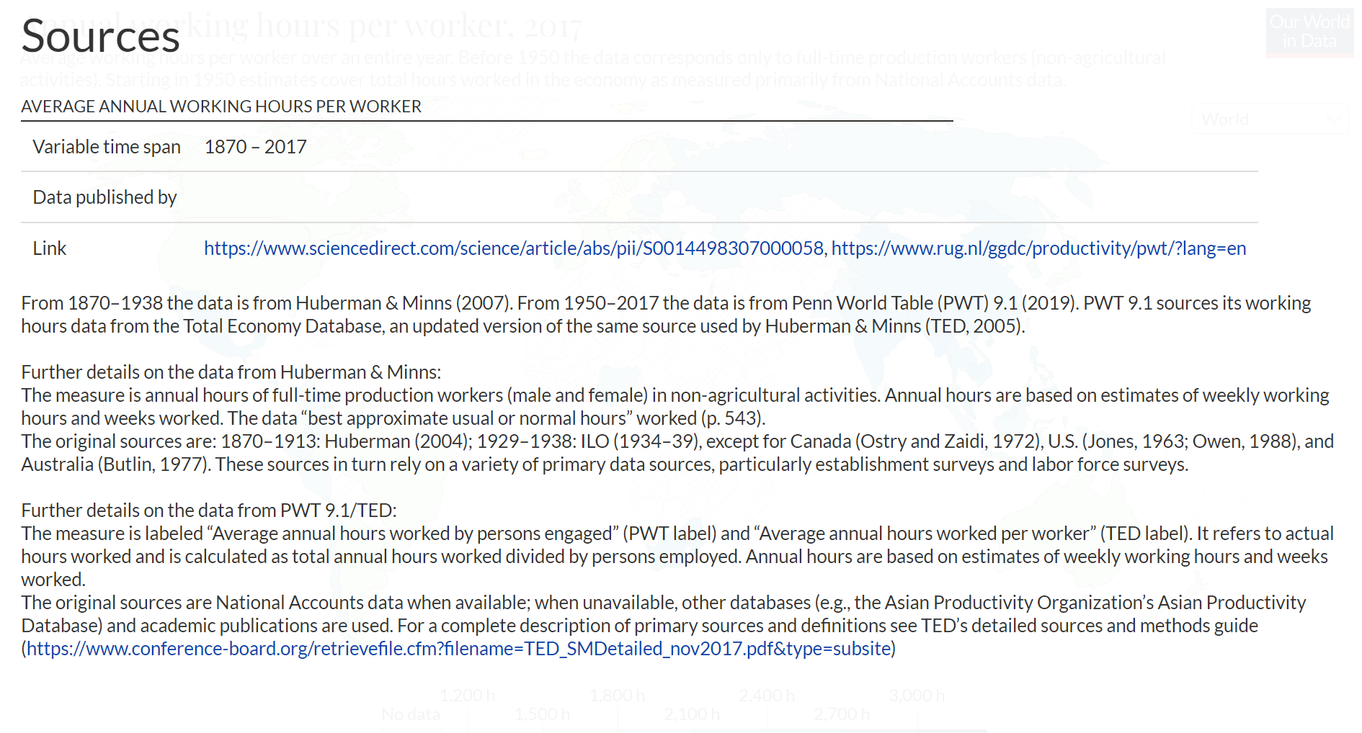

Slide 35
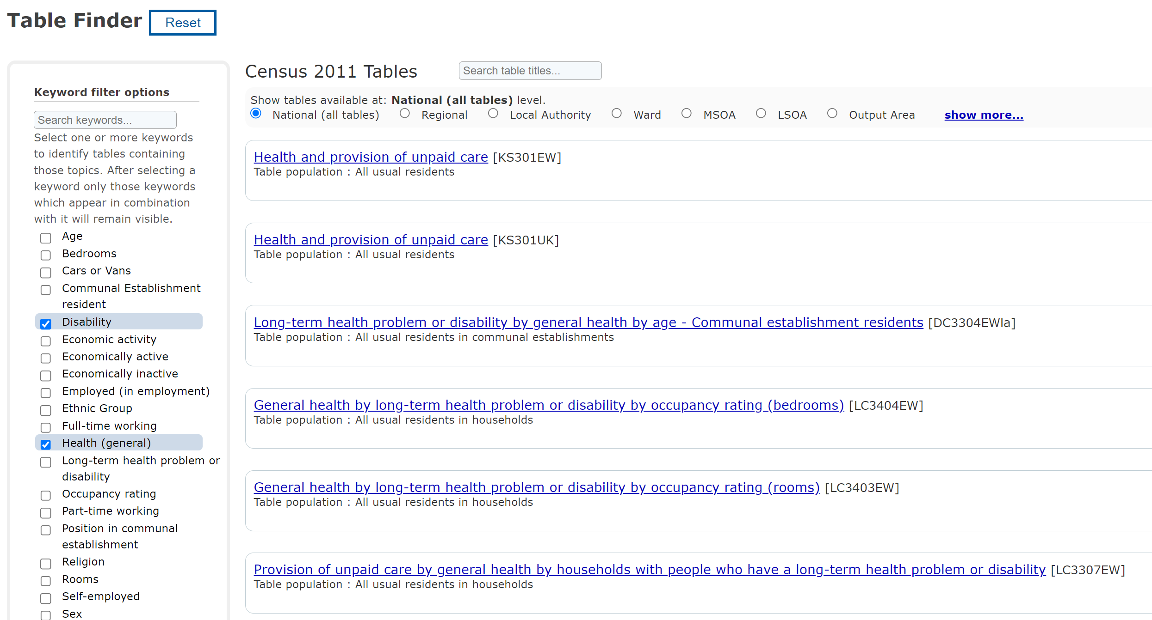

Slide 36
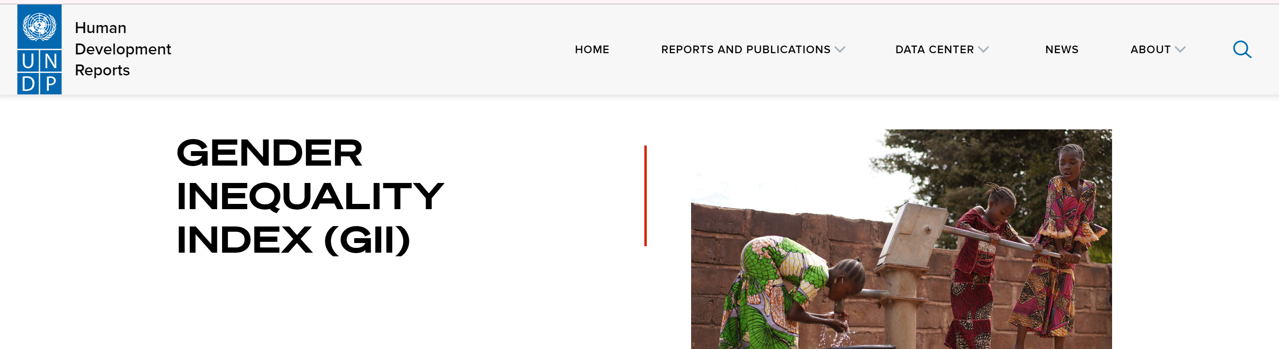
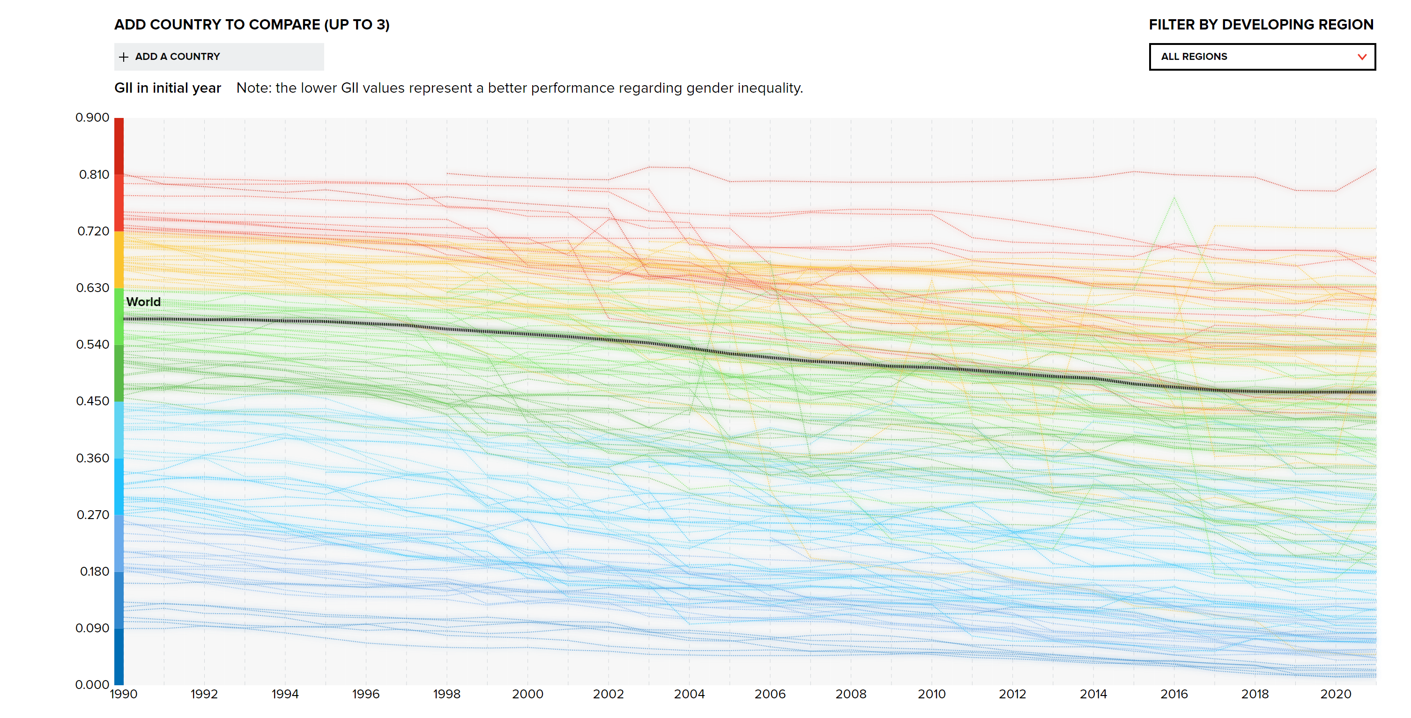
https://hdr.undp.org/data-center/thematic-composite-indices/gender-inequality-index#/indicies/GII

Slide 37
How the 157 000 are distributed across the map
How to link in to the pattern shown in the DI plot?
DI differ by region or time? Main effect?
Reference: https://www.researchgate.net/figure/Map-of-Government-Office-Regions-GORs_fig1_4843923
Notes:
Cultural influence
Mental health prevalence

Slide 38
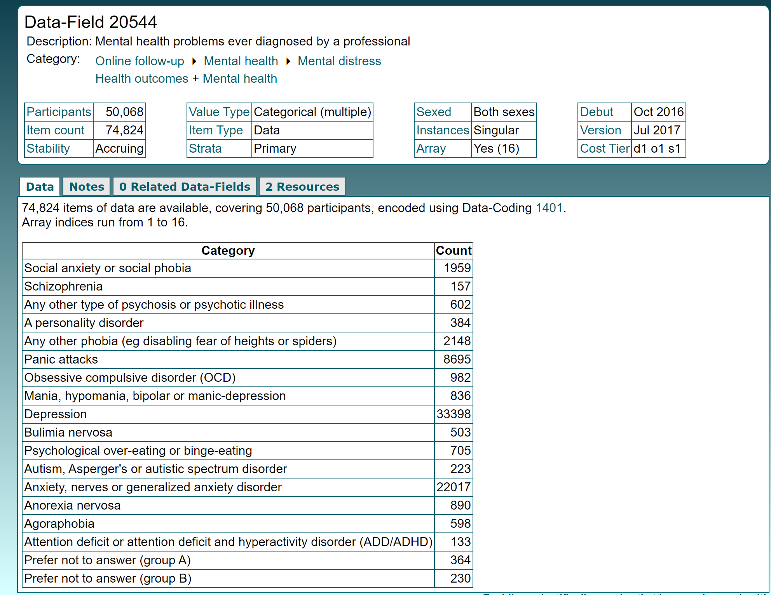

Slide 39
Confounding factors
- Family income (average per region + distribution
In the region (least to most)) --> GIAI
- Immigration/stability of population
- Population density
- Education level
- How wide that region is (the mix of ethnicity)

Slide 40
TO-DO LIST
Show with data that the Duncan Index stays the same whether there are 9 or 17+ categories
Think about the cofounders related to socio-economic status (go over the papers and see which one they pointed out à which one are available on a regional-level)
Check out what is available in terms of health and how was this information collected (survey) and is it true that in some census this info is not available?
How do we assign UK participants according to region and time?

